Slide 1
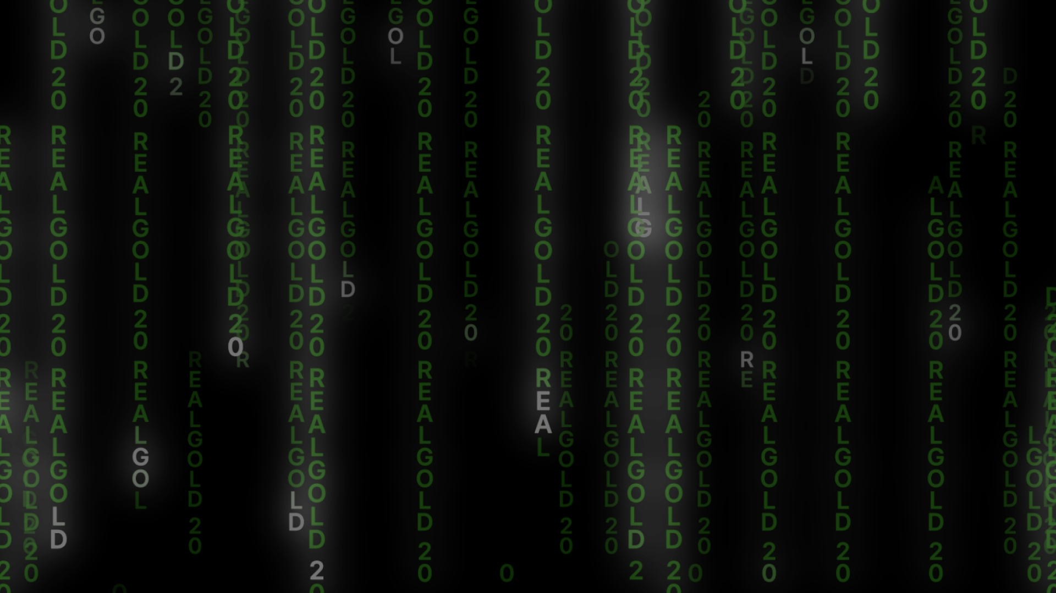
REAL GOLD 2.0
GOLD AND BLOCKCHAIN TECHNOLOGY
AFFILIATE PROGRAM

Slide 2
ABOUT THE REAL GOLD LTD COMPANY
IT HAS BEEN RUNNING SINCE 2015
AUSTRIA
SOUTH AFRICA
SERVICE CENTER IN BUDAPEST (HUNGARY)
DUBAI, UAE
REALGOLD 2.0 is a program for the sale of gold bars of the highest grade 999.9 focused on the sale of the lowest weight bars of 0.10 grams with LBMA certification from well-known gold producers.
The purchase and control of bars, as well as the distribution of commission fees under the REALGOLD 2.0 marketing program takes place through the smart contract of the BINANCE blockchain.

Slide 3
WHY GOLD?
THE MOST RELIABLE FORM OF MONEY IN THE WORLD
LIQUID
DISTRIBUTION
Gold is a market of 12 trillion US dollars.
Public and private ownership of gold is commonplace all over the world.
INSTANT SALE
PRECIOUS
Get competitive gold prices in every city on the globe.
Gold has been used in jewelry and luxury items for thousands of years.
ETERNAL
INDUSTRIAL USE
Timeless gold does not corrode or degrade.
Gold is used in electronics and many other industries.

Slide 4
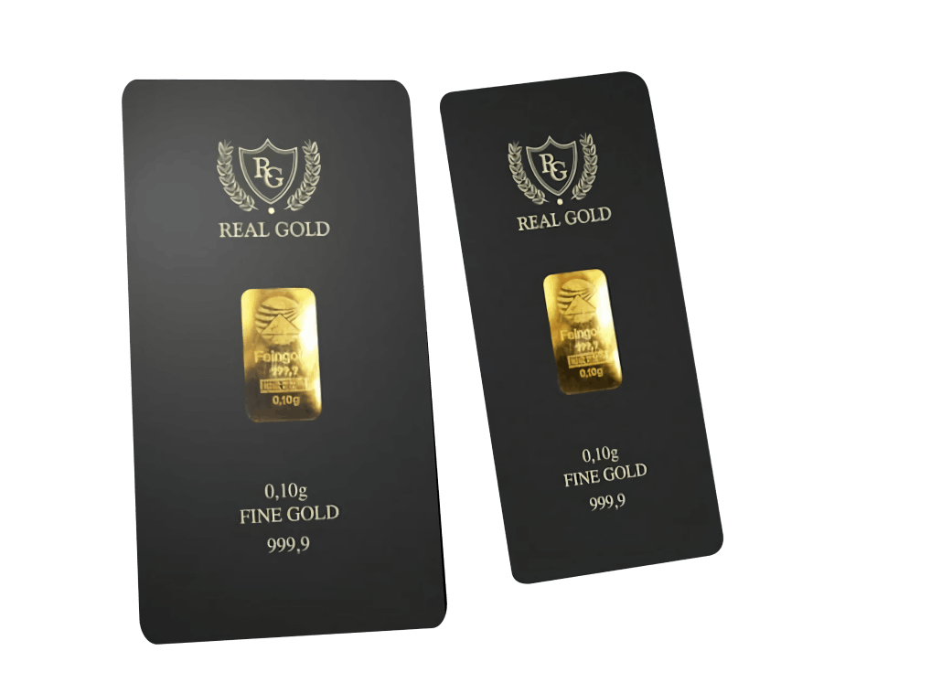
GOLD BARS OF 0.10 G.
WHY IS IT BETTER TO BUY SMALL GOLD BARS?
Buying small gold bars does not compromise any of the major benefits of gold: they are portable, private, liquid and will be relevant forever.
LARGE BARS DO NOT IMPLY DIVISIBILITY INTO SMALLER ONES
When you sell a large bar, you are liquidating a significant personal investment. It is more practical to sell multiple small bars to exchange the exact amount of gold for the exact amount of money you need.

Slide 5
MORE POTENTIAL BUYERS
REDUCING THE RISK OF FORGERY
Not many investors can afford to buy a bar of, say, 5 or 10 g. There are more potential buyers for the purchase of small bars, light weight bars are more accessible. In fact, having some gold is better than not having it at all.
Counterfeiters prefer large bars as their cost is much higher.
THERE IS NO NEED TO ANALYZE THE BAR
SMALL BARS
The larger the bar, the more likely it is that the purity analysis will take longer prior to selling. The analysis adds additional costs, it is inconvenient and will delay payment.
Small bars are also a wonderful gift for any occasion.

Slide 6
REALGOLD 2.0 BLOCKCHAIN
The REALGOLD 2.0 program is a combination of the most ancient, reliable, stable asset with a constantly increasing value, gold, and decentralized blockchain technology.
The blockchain technology allows for a high level of transparency and ease of audit, and participants receive a permanent and immutable proof of ownership, a record of the entire supply chain and storage.
REALGOLD 2.0 PUBLIC BLOCKCHAIN TECHNOLOGY
SCALABLE
IMMEDIATE
PUBLIC
DISTRIBUTED
Easy online distribution, deployment and network effects.
Almost instant settlement of trades.
Fully verifiable proof of gold bar reservation and transaction history.
Resilient, secure and reliable network infrastructure.

Slide 7
REAL GOLD BUSD
The REALGOLD 2.0 program works on the most progressive blockchain, Binance Smart Chain, operates on the BUSD stablecoin, where 1 BUSD = $1. It is the binding to the stablecoin that provides stable and secure operations and profits unlike smart contracts, which operate on coins whose exchange rate can fall or rise sharply.
1
=
1

Slide 8
REAL GOLD 2.0 BINANCE SMART CHAIN SMART CONTRACT
PERSONAL WALLET
The REAL GOLD 2.0 platform is based on the smart contract technology.
To become a member, you need to have or create your own personal cryptocurrency wallet.
Detailed instructions can be found here:
REAL GOLD 2.0 SMART CONTRACT
The main purpose of the smart contract is the instant automatic distribution of funds from incoming transactions to the wallets of participants of the REAL GOLD 2.0 program in accordance with the terms of the marketing program.
chrome-extension://mpbmflco
Reference in the REAL GOLD 2.0 smart contract:
Your referral link remains unchanged, you cannot change your superior partner, as well as your subordinate partners are permanently assigned to you in your structure.

Slide 9
ONLY YOU HAVE ACCESS TO YOUR FUNDS:
All commission fees are instantly deposited into your personal wallet in accordance with marketing.
All information about transactions is stored in the public domain in the blockchain.
You can easily check each transaction and see where the funds were sent.

Slide 10
REAL GOLD 2.0 MARKETING
The REAL GOLD 2.0 BUSD marketing is implemented on the technology of smart contracts of the Smart Chain blockchain. In marketing, the BUSD token is directly used in the BEP-20 format with a stable exchange rate equal to 1 USD.
BUSD TOKEN
BUSD is a cryptocurrency with a constant fixed exchange rate equal to 1 US dollar. It has a fully verified code and is approved by the New York State Department of Financial Services.
The BUSD token can be easily exchanged for any cryptocurrency on DEX exchangers while spending a small commission from the network. To send a BUSD token or any other one functioning in the Smart Chain blockchain, you will need a certain amount of BNB to pay a fee.
BUSD is fully backed by the US dollar in a 1:1 ratio, it can always be exchanged for dollars or other fiat currencies.
It was created in partnership of Paxos and Binance.
The cost of activating levels and recycling on the REAL GOLD platform is indicated in dollar equivalent.

Slide 11
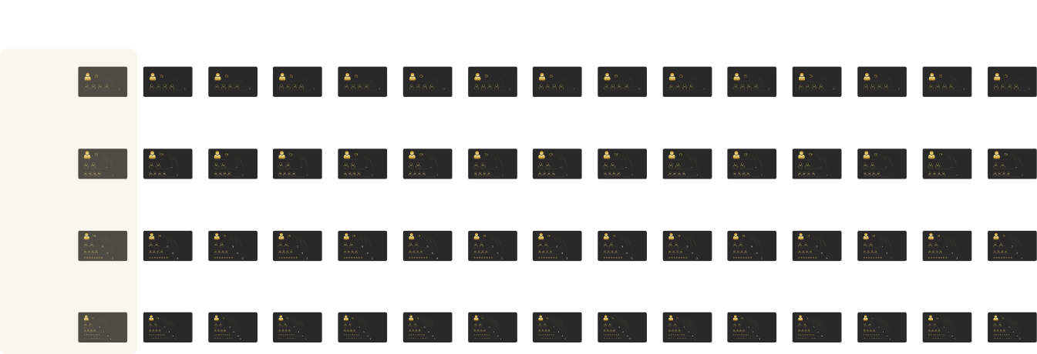
REGISTRATION AND ACTIVATION OF GOLDSETS IN REAL GOLD 2.0
To initially activate goldsets, it is necessary to purchase gold bars of 0.10 g in the REAL GOLD LTD company.
A necessary condition for participation in the REAL GOLD LTD program is the activation of the first Goldsets of all types of GS5, GS7, GS15, GS31 with the lowest cost. In total, it makes the activation of four types of Goldsets: 4 bars of 0.10 g each. One bar goes for each set.
1
2
3
4
5
6
7
8
9
10
11
12
13
14
15
GS5
level 1
level 2
83.3%
level 1
level 2
83.3%
level 1
level 2
83.3%
level 1
level 2
83.3%
level 1
level 2
83.3%
level 1
level 2
83.3%
level 1
level 2
83.3%
level 1
level 2
83.3%
level 1
level 2
83.3%
level 1
level 2
83.3%
level 1
level 2
83.3%
level 1
level 2
83.3%
level 1
level 2
83.3%
level 1
level 2
83.3%
level 1
level 2
83.3%
GS7
level 1
level 2
8.3%
level 1
level 2
8.3%
level 1
level 2
8.3%
level 1
level 2
8.3%
level 1
level 2
8.3%
level 1
level 2
8.3%
level 1
level 2
8.3%
level 1
level 2
8.3%
level 1
level 2
8.3%
level 1
level 2
8.3%
level 1
level 2
8.3%
level 1
level 2
8.3%
level 1
level 2
8.3%
level 1
level 2
8.3%
level 1
level 2
8.3%
level 3
75%
level 3
75%
level 3
75%
level 3
75%
level 3
75%
level 3
75%
level 3
75%
level 3
75%
level 3
75%
level 3
75%
level 3
75%
level 3
75%
level 3
75%
level 3
75%
level 3
75%
GS15
level 1
level 2
16.6%
level 1
level 2
16.6%
level 1
level 2
16.6%
level 1
level 2
16.6%
level 1
level 2
16.6%
level 1
level 2
16.6%
level 1
level 2
16.6%
level 1
level 2
16.6%
level 1
level 2
16.6%
level 1
level 2
16.6%
level 1
level 2
16.6%
level 1
level 2
16.6%
level 1
level 2
16.6%
level 1
level 2
16.6%
level 1
level 2
16.6%
level 3
25%
level 3
25%
level 3
25%
level 3
25%
level 3
25%
level 3
25%
level 3
25%
level 3
25%
level 3
25%
level 3
25%
level 3
25%
level 3
25%
level 3
25%
level 3
25%
level 3
25%
level 4
41.6%
level 4
41.6%
level 4
41.6%
level 4
41.6%
level 4
41.6%
level 4
41.6%
level 4
41.6%
level 4
41.6%
level 4
41.6%
level 4
41.6%
level 4
41.6%
level 4
41.6%
level 4
41.6%
level 4
41.6%
level 4
41.6%
GS31
level 1
level 2
8.3%
level 1
level 2
8.3%
level 1
level 2
8.3%
level 1
level 2
8.3%
level 1
level 2
8.3%
level 1
level 2
8.3%
level 1
level 2
8.3%
level 1
level 2
8.3%
level 1
level 2
8.3%
level 1
level 2
8.3%
level 1
level 2
8.3%
level 1
level 2
8.3%
level 1
level 2
8.3%
level 1
level 2
8.3%
level 1
level 2
8.3%
level 3
16.6%
level 3
16.6%
level 3
16.6%
level 3
16.6%
level 3
16.6%
level 3
16.6%
level 3
16.6%
level 3
16.6%
level 3
16.6%
level 3
16.6%
level 3
16.6%
level 3
16.6%
level 3
16.6%
level 3
16.6%
level 3
16.6%
level 4
25%
level 4
25%
level 4
25%
level 4
25%
level 4
25%
level 4
25%
level 4
25%
level 4
25%
level 4
25%
level 4
25%
level 4
25%
level 4
25%
level 4
25%
level 4
25%
level 4
25%
level 5
33.33%
level 5
33.33%
level 5
33.33%
level 5
33.33%
level 5
33.33%
level 5
33.33%
level 5
33.33%
level 5
33.33%
level 5
33.33%
level 5
33.33%
level 5
33.33%
level 5
33.33%
level 5
33.33%
level 5
33.33%
level 5
33.33%

Slide 12
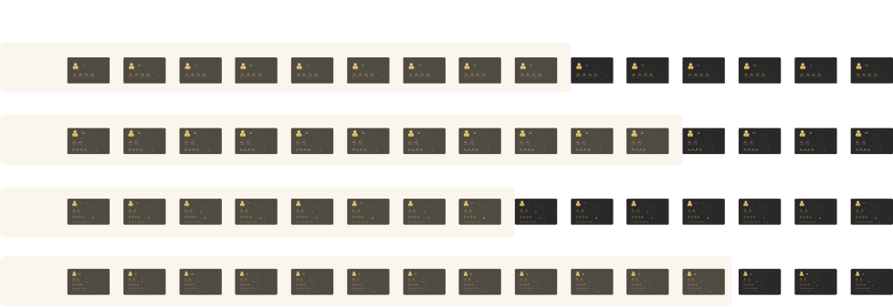
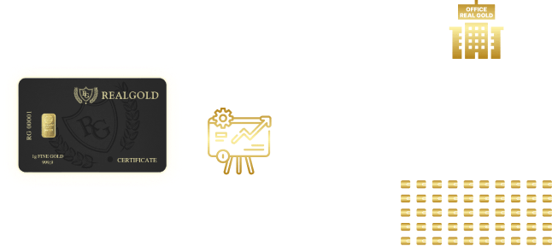
1
2
3
4
5
6
7
8
9
10
11
12
13
14
15
GS5
level 1
level 2
83.3%
level 1
level 2
83.3%
level 1
level 2
83.3%
level 1
level 2
83.3%
level 1
level 2
83.3%
level 1
level 2
83.3%
level 1
level 2
83.3%
level 1
level 2
83.3%
level 1
level 2
83.3%
level 1
level 2
83.3%
level 1
level 2
83.3%
level 1
level 2
83.3%
level 1
level 2
83.3%
level 1
level 2
83.3%
level 1
level 2
83.3%
All Goldsets subsequent by cost can be activated one by one, in ascending order.
GS7
level 1
level 2
8.3%
level 1
level 2
8.3%
level 1
level 2
8.3%
level 1
level 2
8.3%
level 1
level 2
8.3%
level 1
level 2
8.3%
level 1
level 2
8.3%
level 1
level 2
8.3%
level 1
level 2
8.3%
level 1
level 2
8.3%
level 1
level 2
8.3%
level 1
level 2
8.3%
level 1
level 2
8.3%
level 1
level 2
8.3%
level 1
level 2
8.3%
level 3
75%
level 3
75%
level 3
75%
level 3
75%
level 3
75%
level 3
75%
level 3
75%
level 3
75%
level 3
75%
level 3
75%
level 3
75%
level 3
75%
level 3
75%
level 3
75%
level 3
75%
GS15
level 1
level 2
16.6%
level 1
level 2
16.6%
level 1
level 2
16.6%
level 1
level 2
16.6%
level 1
level 2
16.6%
level 1
level 2
16.6%
level 1
level 2
16.6%
level 1
level 2
16.6%
level 1
level 2
16.6%
level 1
level 2
16.6%
level 1
level 2
16.6%
level 1
level 2
16.6%
level 1
level 2
16.6%
level 1
level 2
16.6%
level 1
level 2
16.6%
level 3
25%
level 3
25%
level 3
25%
level 3
25%
level 3
25%
level 3
25%
level 3
25%
level 3
25%
level 3
25%
level 3
25%
level 3
25%
level 3
25%
level 3
25%
level 3
25%
level 3
25%
level 4
41.6%
level 4
41.6%
level 4
41.6%
level 4
41.6%
level 4
41.6%
level 4
41.6%
level 4
41.6%
level 4
41.6%
level 4
41.6%
level 4
41.6%
level 4
41.6%
level 4
41.6%
level 4
41.6%
level 4
41.6%
level 4
41.6%
GS31
level 1
level 2
8.3%
level 1
level 2
8.3%
level 1
level 2
8.3%
level 1
level 2
8.3%
level 1
level 2
8.3%
level 1
level 2
8.3%
level 1
level 2
8.3%
level 1
level 2
8.3%
level 1
level 2
8.3%
level 1
level 2
8.3%
level 1
level 2
8.3%
level 1
level 2
8.3%
level 1
level 2
8.3%
level 1
level 2
8.3%
level 1
level 2
8.3%
level 3
16.6%
level 3
16.6%
level 3
16.6%
level 3
16.6%
level 3
16.6%
level 3
16.6%
level 3
16.6%
level 3
16.6%
level 3
16.6%
level 3
16.6%
level 3
16.6%
level 3
16.6%
level 3
16.6%
level 3
16.6%
level 3
16.6%
level 4
25%
level 4
25%
level 4
25%
level 4
25%
level 4
25%
level 4
25%
level 4
25%
level 4
25%
level 4
25%
level 4
25%
level 4
25%
level 4
25%
level 4
25%
level 4
25%
level 4
25%
level 5
33.33%
level 5
33.33%
level 5
33.33%
level 5
33.33%
level 5
33.33%
level 5
33.33%
level 5
33.33%
level 5
33.33%
level 5
33.33%
level 5
33.33%
level 5
33.33%
level 5
33.33%
level 5
33.33%
level 5
33.33%
level 5
33.33%
The cost of marketing charges for each purchase of one gold bar is $6 BUSD; of this amount, 16.7% is the company's income, as well as 16.7% is the company's income for each reinvestment and each transition and activation of higher-cost Goldsets, and 83.3% is distributed according to the marketing plan to the participants of the REAL GOLD 2.0 program.
OFFICE REAL GOLD
6 USDT
16,7%
83,3%

Slide 13
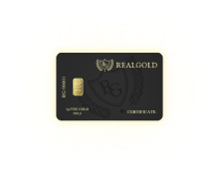
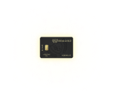
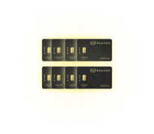
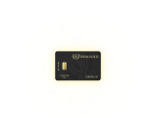
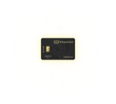
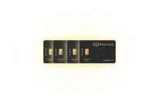
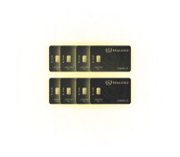
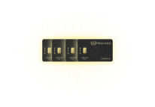
1
2
3
4
5
6
7
8
9
10
11
12
13
14
15
1
2
4
8
16
32
64
128
256
512
1024
2048
4096
8192
16 384
GS5
level 1
level 2
83.3%
level 1
level 2
83.3%
level 1
level 2
83.3%
level 1
level 2
83.3%
level 1
level 2
83.3%
level 1
level 2
83.3%
level 1
level 2
83.3%
level 1
level 2
83.3%
level 1
level 2
83.3%
level 1
level 2
83.3%
level 1
level 2
83.3%
level 1
level 2
83.3%
level 1
level 2
83.3%
level 1
level 2
83.3%
level 1
level 2
83.3%
GS7
level 1
level 2
8.3%
level 1
level 2
8.3%
level 1
level 2
8.3%
level 1
level 2
8.3%
level 1
level 2
8.3%
level 1
level 2
8.3%
level 1
level 2
8.3%
level 1
level 2
8.3%
level 1
level 2
8.3%
level 1
level 2
8.3%
level 1
level 2
8.3%
level 1
level 2
8.3%
level 1
level 2
8.3%
level 1
level 2
8.3%
level 1
level 2
8.3%
level 3
75%
level 3
75%
level 3
75%
level 3
75%
level 3
75%
level 3
75%
level 3
75%
level 3
75%
level 3
75%
level 3
75%
level 3
75%
level 3
75%
level 3
75%
level 3
75%
level 3
75%
GS15
level 1
level 2
16.6%
level 1
level 2
16.6%
level 1
level 2
16.6%
level 1
level 2
16.6%
level 1
level 2
16.6%
level 1
level 2
16.6%
level 1
level 2
16.6%
level 1
level 2
16.6%
level 1
level 2
16.6%
level 1
level 2
16.6%
level 1
level 2
16.6%
level 1
level 2
16.6%
level 1
level 2
16.6%
level 1
level 2
16.6%
level 1
level 2
16.6%
level 3
25%
level 3
25%
level 3
25%
level 3
25%
level 3
25%
level 3
25%
level 3
25%
level 3
25%
level 3
25%
level 3
25%
level 3
25%
level 3
25%
level 3
25%
level 3
25%
level 3
25%
level 4
41.6%
level 4
41.6%
level 4
41.6%
level 4
41.6%
level 4
41.6%
level 4
41.6%
level 4
41.6%
level 4
41.6%
level 4
41.6%
level 4
41.6%
level 4
41.6%
level 4
41.6%
level 4
41.6%
level 4
41.6%
level 4
41.6%
GS31
level 1
level 2
8.3%
level 1
level 2
8.3%
level 1
level 2
8.3%
level 1
level 2
8.3%
level 1
level 2
8.3%
level 1
level 2
8.3%
level 1
level 2
8.3%
level 1
level 2
8.3%
level 1
level 2
8.3%
level 1
level 2
8.3%
level 1
level 2
8.3%
level 1
level 2
8.3%
level 1
level 2
8.3%
level 1
level 2
8.3%
level 1
level 2
8.3%
level 3
16.6%
level 3
16.6%
level 3
16.6%
level 3
16.6%
level 3
16.6%
level 3
16.6%
level 3
16.6%
level 3
16.6%
level 3
16.6%
level 3
16.6%
level 3
16.6%
level 3
16.6%
level 3
16.6%
level 3
16.6%
level 3
16.6%
level 4
25%
level 4
25%
level 4
25%
level 4
25%
level 4
25%
level 4
25%
level 4
25%
level 4
25%
level 4
25%
level 4
25%
level 4
25%
level 4
25%
level 4
25%
level 4
25%
level 4
25%
level 5
33.33%
level 5
33.33%
level 5
33.33%
level 5
33.33%
level 5
33.33%
level 5
33.33%
level 5
33.33%
level 5
33.33%
level 5
33.33%
level 5
33.33%
level 5
33.33%
level 5
33.33%
level 5
33.33%
level 5
33.33%
level 5
33.33%
Each type of Goldsets has fifteen cost levels. The cost of activating each next level, as well as income on Goldsets, is twice as much as the previous set. Goldsets of all types of GS5, GS7, GS15, GS31 being the first by cost are always activated together and cannot be accessed separately.
For the first activation of each subsequent Goldset, the cost increases 2 times exactly compared to the previous one. The first set is one bar, the second is 2 bars, the third is 4 bars, the fourth is 8 bars, and so on.

Slide 14
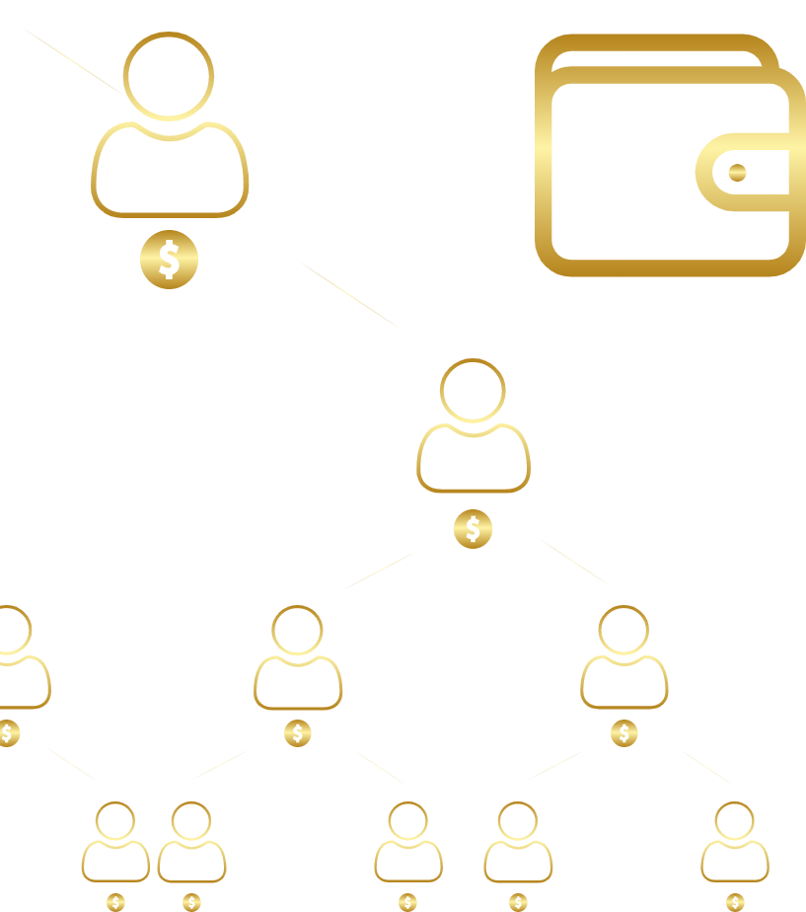
The transaction for the purchase of gold bars goes to the smart contract and it redirects funds to the personal wallets of the program participants, whose places are on these sets.

Slide 15
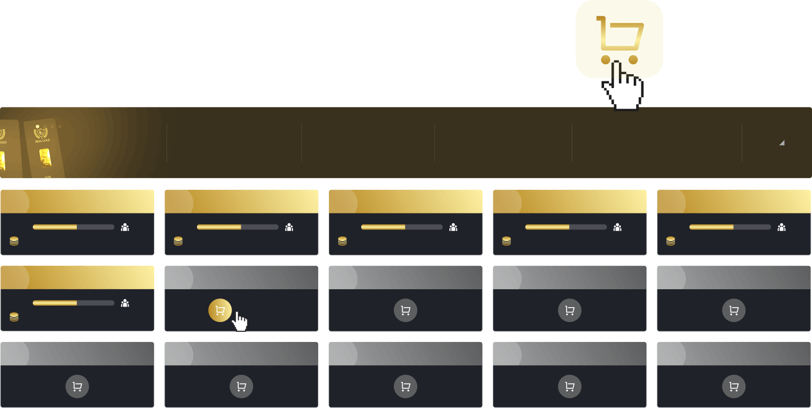
You occupy the top places in your chosen Goldsets.
Goldset GS 5
Active goldsets
Direct partners
Partners in total
Current income in total:
6
4
5
$55 121
1
Goldbar 1 (0.10г)
2
Goldbar 2 (0.10г)
3
Goldbar 4 (0.10г)
4
Goldbar 8 (0.10г)
5
Goldbar 16 (0.10г)
100%
2/4
100%
2/4
100%
2/4
100%
2/4
100%
2/4
max income
24 USDT
max income
24 USDT
max income
24 USDT
max income
24 USDT
max income
24 USDT
6
Goldbar 32 (0.10г)
7
Goldbar 64 (0.10г)
8
Goldbar 128 (0.10г)
9
Goldbar 256 (0.10г)
10
Goldbar 512 (0.10г)
100%
2/4
Activate
max income
24 USDT
11
Goldbar 1024 (0.10г)
12
Goldbar 2048 (0.10г)
13
Goldbar 4096 (0.10г)
14
Goldbar 8192 (0.10г)
15
Goldbar 16384 (0.10г)

Slide 16
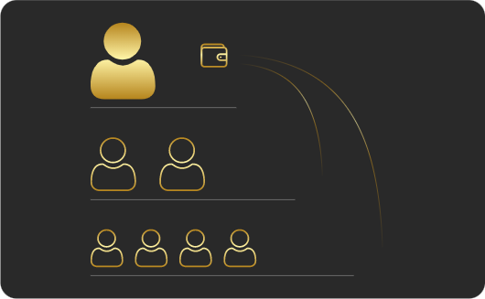
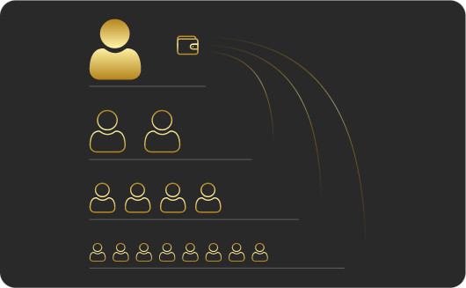
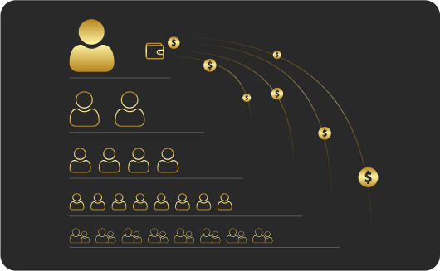
YOU
YOU
After choosing and paying, your Goldsets are activated and now you can invite partners using your personal referral link.
Detailed registration instructions can be found here:
GOLDSET GS5
level 1
GOLDSET GS7
level 1
level 2
level 2
level 3
YOU
YOU
level 1
GOLDSET GS15
level 1
GOLDSET GS31
level 2
level 2
chrome-extension://mpbmflco
level 3
level 3
level 4
level 4
level 5

Slide 17
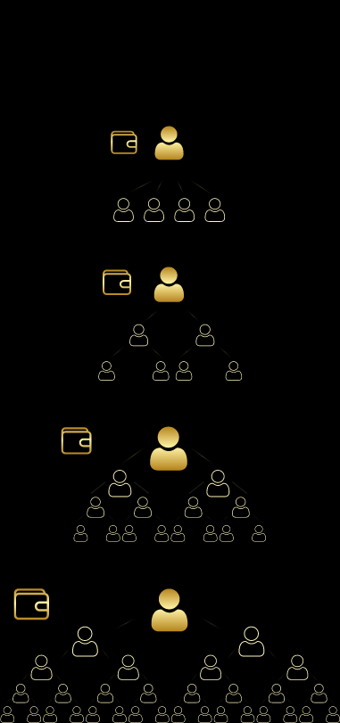
1
GS5, GS7, GS15, GS31 Goldsets were developed for accounting and distribution of fees in the REAL GOLD 2.0 marketing. They are based on a matrix system and set up on the decentralized smart contract technology.
The participants' income is formed on the basis of inviting new partners to their team securing them forever, as well as through constant reinvestments and floating. All actions on the REAL GOLD 2.0 platform are recorded in the blockchain through a smart contract.
GS5
You
GS7
Вы
GS15
You
GS31
You

Slide 18
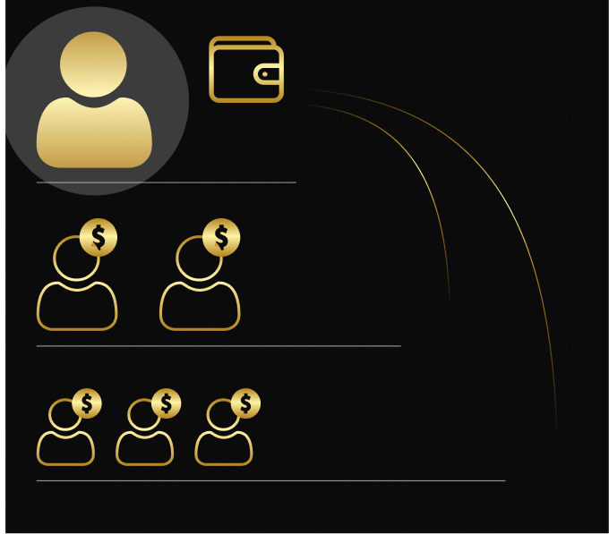
YOU
The income from all the partners' places is instantly transferred to the personal wallets of the program participants.
level 1
level 2
level 3

Slide 19
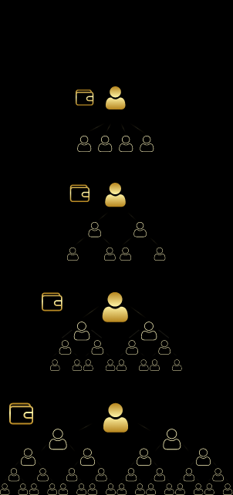
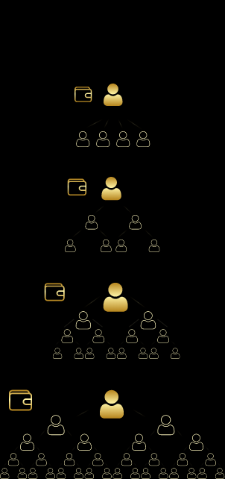
The program provides 4 types of GS5, GS7, GS15, GS31 Goldsets, differing in profitability and terms of interaction between partners. The most effective method of generating income is parallel activation and simultaneous use of all Goldsets.
1
2
3
4
5
GS5
You
You
You
You
You
GS7
Вы
Вы
Вы
Вы
Вы
GS15
You
You
You
You
You
GS31
You
You
You
You
You

Slide 20
1
2
3
4
5
6
7
8
9
6
GS5
You
You
You
You
You
You
You
You
You
GS7
Вы
Вы
Вы
Вы
Вы
Вы
Вы
Вы
Вы
GS15
You
You
You
You
You
You
You
You
You
GS31
You
You
You
You
You
You
You
You
You
You
The validity period of Goldsets is not limited. Through activating any Goldset level once, it is assigned to you forever and does not require additional costs.

Slide 21
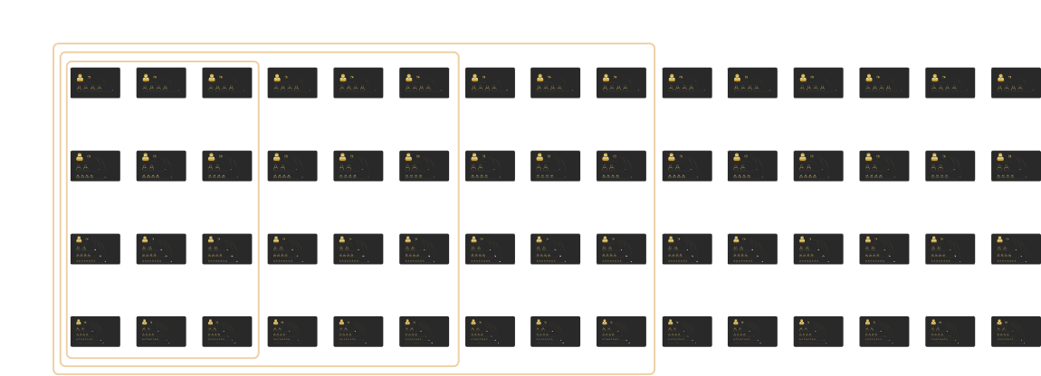
1
2
3
4
5
6
7
8
9
10
11
12
13
14
15
GS5
level 1
level 2
83.3%
level 1
level 2
83.3%
level 1
level 2
83.3%
level 1
level 2
83.3%
level 1
level 2
83.3%
level 1
level 2
83.3%
level 1
level 2
83.3%
level 1
level 2
83.3%
level 1
level 2
83.3%
level 1
level 2
83.3%
level 1
level 2
83.3%
level 1
level 2
83.3%
level 1
level 2
83.3%
level 1
level 2
83.3%
level 1
level 2
83.3%
GS7
level 1
level 2
8.3%
level 1
level 2
8.3%
level 1
level 2
8.3%
level 1
level 2
8.3%
level 1
level 2
8.3%
level 1
level 2
8.3%
level 1
level 2
8.3%
level 1
level 2
8.3%
level 1
level 2
8.3%
level 1
level 2
8.3%
level 1
level 2
8.3%
level 1
level 2
8.3%
level 1
level 2
8.3%
level 1
level 2
8.3%
level 1
level 2
8.3%
level 3
75%
level 3
75%
level 3
75%
level 3
75%
level 3
75%
level 3
75%
level 3
75%
level 3
75%
level 3
75%
level 3
75%
level 3
75%
level 3
75%
level 3
75%
level 3
75%
level 3
75%
GS15
level 1
level 2
16.6%
level 1
level 2
16.6%
level 1
level 2
16.6%
level 1
level 2
16.6%
level 1
level 2
16.6%
level 1
level 2
16.6%
level 1
level 2
16.6%
level 1
level 2
16.6%
level 1
level 2
16.6%
level 1
level 2
16.6%
level 1
level 2
16.6%
level 1
level 2
16.6%
level 1
level 2
16.6%
level 1
level 2
16.6%
level 1
level 2
16.6%
level 3
25%
level 3
25%
level 3
25%
level 3
25%
level 3
25%
level 3
25%
level 3
25%
level 3
25%
level 3
25%
level 3
25%
level 3
25%
level 3
25%
level 3
25%
level 3
25%
level 3
25%
level 4
41.6%
level 4
41.6%
level 4
41.6%
level 4
41.6%
level 4
41.6%
level 4
41.6%
level 4
41.6%
level 4
41.6%
level 4
41.6%
level 4
41.6%
level 4
41.6%
level 4
41.6%
level 4
41.6%
level 4
41.6%
level 4
41.6%
GS31
level 1
level 2
8.3%
level 1
level 2
8.3%
level 1
level 2
8.3%
level 1
level 2
8.3%
level 1
level 2
8.3%
level 1
level 2
8.3%
level 1
level 2
8.3%
level 1
level 2
8.3%
level 1
level 2
8.3%
level 1
level 2
8.3%
level 1
level 2
8.3%
level 1
level 2
8.3%
level 1
level 2
8.3%
level 1
level 2
8.3%
level 1
level 2
8.3%
level 3
16.6%
level 3
16.6%
level 3
16.6%
level 3
16.6%
level 3
16.6%
level 3
16.6%
level 3
16.6%
level 3
16.6%
level 3
16.6%
level 3
16.6%
level 3
16.6%
level 3
16.6%
level 3
16.6%
level 3
16.6%
level 3
16.6%
level 4
25%
level 4
25%
level 4
25%
level 4
25%
level 4
25%
level 4
25%
level 4
25%
level 4
25%
level 4
25%
level 4
25%
level 4
25%
level 4
25%
level 4
25%
level 4
25%
level 4
25%
level 5
33.33%
level 5
33.33%
level 5
33.33%
level 5
33.33%
level 5
33.33%
level 5
33.33%
level 5
33.33%
level 5
33.33%
level 5
33.33%
level 5
33.33%
level 5
33.33%
level 5
33.33%
level 5
33.33%
level 5
33.33%
level 5
33.33%
Through activating Goldsets of higher cost levels, you automatically increase your income. The income in the marketing program is formed from the cost of the Goldset in which your partners occupy places. Therefore, working at higher cost levels of Goldsets increases your total income by several times. The marketing plan is designed in such a way that the income from one cycle (filling the Goldset) is enough to move to the next cost level of the Goldset of same type and to the Goldset of exactly the same cost (reinvestment).

Slide 22
Х2
Х2
You
You
You
Automatic cycles (reinvestments) are provided at all cost levels of Goldsets. Each type of Goldsets consists of a certain number of levels on which a fixed number of places are located. After all the Goldset places are filled, a new cycle will automatically start.

Slide 23
THE NUMBER OF CYCLES IS UNLIMITED
Once activated by you, the Goldset allows you inviting an unlimited number of new partners.
REFERRAL LINKING
All personal partners that you invite are assigned to you forever and it is impossible to change this since it is fixed in the blockchain through a smart contract.

Slide 24
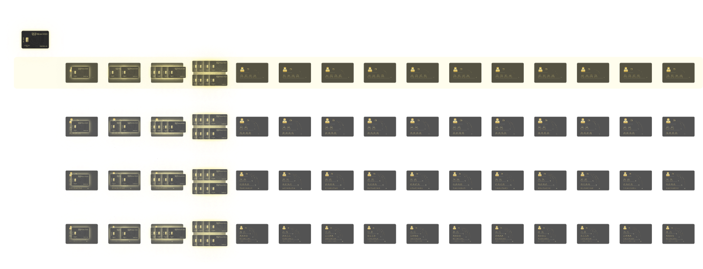
1
2
3
4
5
6
7
8
9
10
11
12
13
14
15
1
2
4
8
16
32
64
128
256
512
1024
2048
4096
8192
16 384
GS5
level 1
level 2
83.3%
level 1
level 2
83.3%
level 1
level 2
83.3%
level 1
level 2
83.3%
level 1
level 2
83.3%
level 1
level 2
83.3%
level 1
level 2
83.3%
level 1
level 2
83.3%
level 1
level 2
83.3%
level 1
level 2
83.3%
level 1
level 2
83.3%
level 1
level 2
83.3%
level 1
level 2
83.3%
level 1
level 2
83.3%
level 1
level 2
83.3%
GS7
level 1
level 2
8.3%
level 1
level 2
8.3%
level 1
level 2
8.3%
level 1
level 2
8.3%
level 1
level 2
8.3%
level 1
level 2
8.3%
level 1
level 2
8.3%
level 1
level 2
8.3%
level 1
level 2
8.3%
level 1
level 2
8.3%
level 1
level 2
8.3%
level 1
level 2
8.3%
level 1
level 2
8.3%
level 1
level 2
8.3%
level 1
level 2
8.3%
level 3
75%
level 3
75%
level 3
75%
level 3
75%
level 3
75%
level 3
75%
level 3
75%
level 3
75%
level 3
75%
level 3
75%
level 3
75%
level 3
75%
level 3
75%
level 3
75%
level 3
75%
GS15
level 1
level 2
16.6%
level 1
level 2
16.6%
level 1
level 2
16.6%
level 1
level 2
16.6%
level 1
level 2
16.6%
level 1
level 2
16.6%
level 1
level 2
16.6%
level 1
level 2
16.6%
level 1
level 2
16.6%
level 1
level 2
16.6%
level 1
level 2
16.6%
level 1
level 2
16.6%
level 1
level 2
16.6%
level 1
level 2
16.6%
level 1
level 2
16.6%
level 3
25%
level 3
25%
level 3
25%
level 3
25%
level 3
25%
level 3
25%
level 3
25%
level 3
25%
level 3
25%
level 3
25%
level 3
25%
level 3
25%
level 3
25%
level 3
25%
level 3
25%
level 4
41.6%
level 4
41.6%
level 4
41.6%
level 4
41.6%
level 4
41.6%
level 4
41.6%
level 4
41.6%
level 4
41.6%
level 4
41.6%
level 4
41.6%
level 4
41.6%
level 4
41.6%
level 4
41.6%
level 4
41.6%
level 4
41.6%
GS31
level 1
level 2
8.3%
level 1
level 2
8.3%
level 1
level 2
8.3%
level 1
level 2
8.3%
level 1
level 2
8.3%
level 1
level 2
8.3%
level 1
level 2
8.3%
level 1
level 2
8.3%
level 1
level 2
8.3%
level 1
level 2
8.3%
level 1
level 2
8.3%
level 1
level 2
8.3%
level 1
level 2
8.3%
level 1
level 2
8.3%
level 1
level 2
8.3%
level 3
16.6%
level 3
16.6%
level 3
16.6%
level 3
16.6%
level 3
16.6%
level 3
16.6%
level 3
16.6%
level 3
16.6%
level 3
16.6%
level 3
16.6%
level 3
16.6%
level 3
16.6%
level 3
16.6%
level 3
16.6%
level 3
16.6%
level 4
25%
level 4
25%
level 4
25%
level 4
25%
level 4
25%
level 4
25%
level 4
25%
level 4
25%
level 4
25%
level 4
25%
level 4
25%
level 4
25%
level 4
25%
level 4
25%
level 4
25%
level 5
33.33%
level 5
33.33%
level 5
33.33%
level 5
33.33%
level 5
33.33%
level 5
33.33%
level 5
33.33%
level 5
33.33%
level 5
33.33%
level 5
33.33%
level 5
33.33%
level 5
33.33%
level 5
33.33%
level 5
33.33%
level 5
33.33%
GS5 GOLDSET
There are 15 GS5 Goldsets in total. The sets differ in cost, each subsequent one is twice as expensive as the previous one. The minimum activation of the smallest GS5 Goldset is one bar. Subsequent activations are with a doubling of the cost on each set.

Slide 25
GS5 GOLDSET
There are two levels:
Level 1: You
You are always on the first level;
level 2 includes four places
Net income of each cycle amounts to 333%.
You
333%

Slide 26
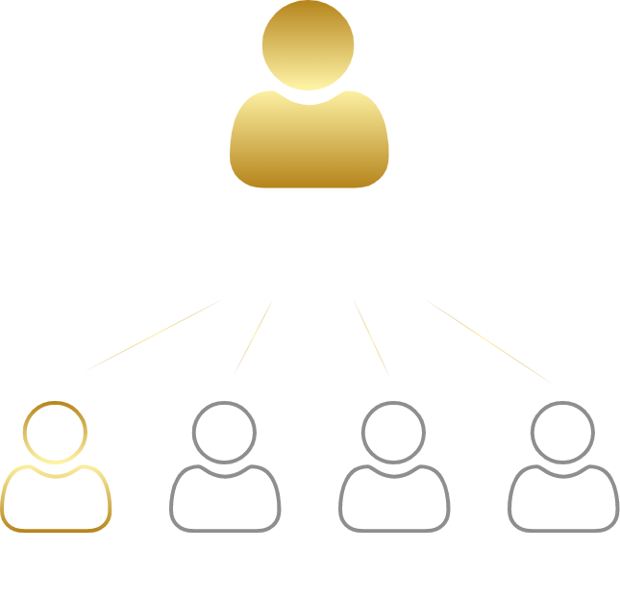
GS5 GOLDSET
The distribution of rewards for completing each level of the program is as follows:
The first partner you invite takes the first place on the 2nd level from left to right below you. Your income will be 83.3% of the commission fees for the second level depending on the amount of the activation cost of each Goldset.
You
83.3%

Slide 27
GS5 GOLDSET
The second person you invite takes the second place below you and you also get an income of 83.3%. The third partner takes the third place below you and again the income is 83.3%. The fourth partner takes the fourth place below you and closes the first cycle. Your income is 83.3% of the commission fees depending on the amount of the activation cost of each Goldset.
You
83%
83%
83%
83%

Slide 28
GS5 GOLDSET
Х2
When the GS5 of each cost level is filled for the first time, four last places form a pool to move to the next cost level of the Goldset and to reactivate a Goldset of the same cost, reinvest, at the same time.
Reinvestment and transition to a higher cost level occur automatically when each Goldset is fully completed.

Slide 29
GS5 GOLDSET
With each re-filling of GS5, two last places form a reinvestment to reactivate the Goldset of the same cost. Re-activation (reinvestment) of Goldsets of each cost level occur automatically an infinite number of times.
Your invitees also move to new levels with higher costs of Goldsets and reinvest in those already passed, filling places on your new and old Goldsets.

Slide 30
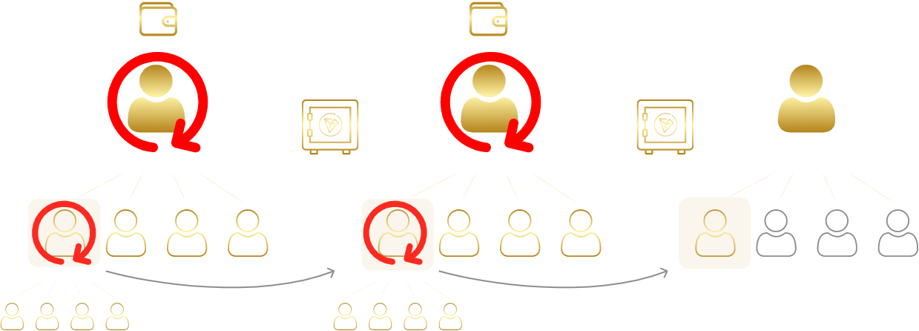
GS5 GOLDSET
Х2
Х2
Each time your lower-level partner completes the cycle of their Goldset cost level, you receive a reward of 83.3% of the commission fees depending on the amount of the cost of each Goldset, and the partner opens a new cycle in their Goldset again. At the same time, this partner takes a new place below you. Thus, the same partner can occupy several places in a row on your Goldsets.

Slide 31
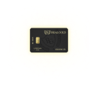
1
2
3
4
5
6
7
8
9
10
11
12
13
14
15
1
2
4
8
16
32
64
128
256
512
1024
2048
4096
8192
16 384
GS5
level 1
level 2
83.3%
level 1
level 2
83.3%
level 1
level 2
83.3%
level 1
level 2
83.3%
level 1
level 2
83.3%
level 1
level 2
83.3%
level 1
level 2
83.3%
level 1
level 2
83.3%
level 1
level 2
83.3%
level 1
level 2
83.3%
level 1
level 2
83.3%
level 1
level 2
83.3%
level 1
level 2
83.3%
level 1
level 2
83.3%
level 1
level 2
83.3%
GS7
level 1
level 2
8.3%
level 1
level 2
8.3%
level 1
level 2
8.3%
level 1
level 2
8.3%
level 1
level 2
8.3%
level 1
level 2
8.3%
level 1
level 2
8.3%
level 1
level 2
8.3%
level 1
level 2
8.3%
level 1
level 2
8.3%
level 1
level 2
8.3%
level 1
level 2
8.3%
level 1
level 2
8.3%
level 1
level 2
8.3%
level 1
level 2
8.3%
level 3
75%
level 3
75%
level 3
75%
level 3
75%
level 3
75%
level 3
75%
level 3
75%
level 3
75%
level 3
75%
level 3
75%
level 3
75%
level 3
75%
level 3
75%
level 3
75%
level 3
75%
GS15
level 1
level 2
16.6%
level 1
level 2
16.6%
level 1
level 2
16.6%
level 1
level 2
16.6%
level 1
level 2
16.6%
level 1
level 2
16.6%
level 1
level 2
16.6%
level 1
level 2
16.6%
level 1
level 2
16.6%
level 1
level 2
16.6%
level 1
level 2
16.6%
level 1
level 2
16.6%
level 1
level 2
16.6%
level 1
level 2
16.6%
level 1
level 2
16.6%
level 3
25%
level 3
25%
level 3
25%
level 3
25%
level 3
25%
level 3
25%
level 3
25%
level 3
25%
level 3
25%
level 3
25%
level 3
25%
level 3
25%
level 3
25%
level 3
25%
level 3
25%
level 4
41.6%
level 4
41.6%
level 4
41.6%
level 4
41.6%
level 4
41.6%
level 4
41.6%
level 4
41.6%
level 4
41.6%
level 4
41.6%
level 4
41.6%
level 4
41.6%
level 4
41.6%
level 4
41.6%
level 4
41.6%
level 4
41.6%
GS31
level 1
level 2
8.3%
level 1
level 2
8.3%
level 1
level 2
8.3%
level 1
level 2
8.3%
level 1
level 2
8.3%
level 1
level 2
8.3%
level 1
level 2
8.3%
level 1
level 2
8.3%
level 1
level 2
8.3%
level 1
level 2
8.3%
level 1
level 2
8.3%
level 1
level 2
8.3%
level 1
level 2
8.3%
level 1
level 2
8.3%
level 1
level 2
8.3%
level 3
16.6%
level 3
16.6%
level 3
16.6%
level 3
16.6%
level 3
16.6%
level 3
16.6%
level 3
16.6%
level 3
16.6%
level 3
16.6%
level 3
16.6%
level 3
16.6%
level 3
16.6%
level 3
16.6%
level 3
16.6%
level 3
16.6%
level 4
25%
level 4
25%
level 4
25%
level 4
25%
level 4
25%
level 4
25%
level 4
25%
level 4
25%
level 4
25%
level 4
25%
level 4
25%
level 4
25%
level 4
25%
level 4
25%
level 4
25%
level 5
33.33%
level 5
33.33%
level 5
33.33%
level 5
33.33%
level 5
33.33%
level 5
33.33%
level 5
33.33%
level 5
33.33%
level 5
33.33%
level 5
33.33%
level 5
33.33%
level 5
33.33%
level 5
33.33%
level 5
33.33%
level 5
33.33%
GS7 GOLDSET
There are 15 GS7 Goldsets in total. The sets differ in cost, each subsequent one is twice as expensive as the previous one. The minimum activation of the smallest GS7 Goldset is one bar. Subsequent activations are with a doubling of the cost on each set.

Slide 32
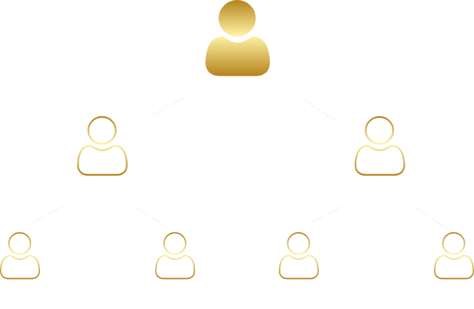
GS7 GOLDSET
There are three levels:
Level 1: You
You are always on the first level;
the second level includes two places: your income is 8.3% from each activation of a place in your Goldset depending on the activation cost of each Goldset.
The third level includes four places: your income is 75% from each filled place in your Goldset depending on the amount of activation of each Goldset.
Net income of each cycle of your place amounts to 317%.
You
8.3%
8.3%
75%
75%
75%
75%
317%

Slide 33
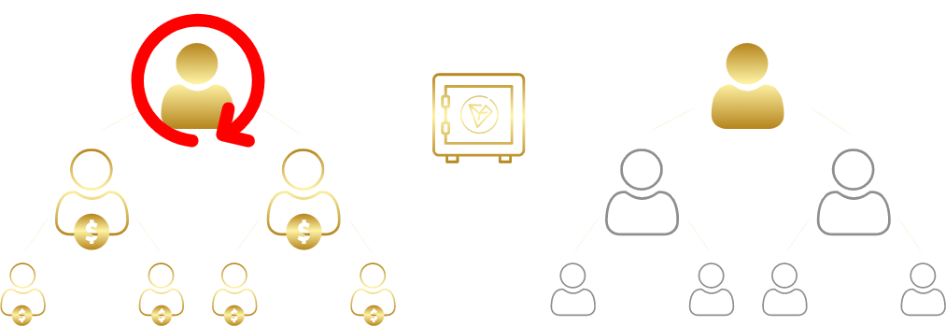
GS7 GOLDSET
You
You
Х2
When the GS7 of each cost level is filled for the first time, three to four last places form a pool to move to the next cost level of the Goldset and to reactivate a Goldset of the same cost, reinvest, at the same time.
Reinvestment and transition to a higher cost level occur automatically when each Goldset is fully completed.

Slide 34
GS7 GOLDSET
Вы
Вы
Вы
With each re-filling of GS7, two last places form a reinvestment to reactivate the Goldset of the same cost. Re-activation of Goldsets of each cost level occur automatically an infinite number of times.
Your invitees also move to new cost levels of Goldsets and reinvest in those already passed, filling places on your new and old Goldsets.

Slide 35
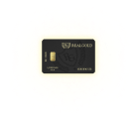
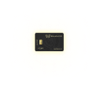
1
2
3
4
5
6
7
8
9
10
11
12
13
14
15
1
2
4
8
16
32
64
128
256
512
1024
2048
4096
8192
16 384
GS5
level 1
level 2
83.3%
level 1
level 2
83.3%
level 1
level 2
83.3%
level 1
level 2
83.3%
level 1
level 2
83.3%
level 1
level 2
83.3%
level 1
level 2
83.3%
level 1
level 2
83.3%
level 1
level 2
83.3%
level 1
level 2
83.3%
level 1
level 2
83.3%
level 1
level 2
83.3%
level 1
level 2
83.3%
level 1
level 2
83.3%
level 1
level 2
83.3%
GS7
level 1
level 2
8.3%
level 1
level 2
8.3%
level 1
level 2
8.3%
level 1
level 2
8.3%
level 1
level 2
8.3%
level 1
level 2
8.3%
level 1
level 2
8.3%
level 1
level 2
8.3%
level 1
level 2
8.3%
level 1
level 2
8.3%
level 1
level 2
8.3%
level 1
level 2
8.3%
level 1
level 2
8.3%
level 1
level 2
8.3%
level 1
level 2
8.3%
level 3
75%
level 3
75%
level 3
75%
level 3
75%
level 3
75%
level 3
75%
level 3
75%
level 3
75%
level 3
75%
level 3
75%
level 3
75%
level 3
75%
level 3
75%
level 3
75%
level 3
75%
GS15
level 1
level 2
16.6%
level 1
level 2
16.6%
level 1
level 2
16.6%
level 1
level 2
16.6%
level 1
level 2
16.6%
level 1
level 2
16.6%
level 1
level 2
16.6%
level 1
level 2
16.6%
level 1
level 2
16.6%
level 1
level 2
16.6%
level 1
level 2
16.6%
level 1
level 2
16.6%
level 1
level 2
16.6%
level 1
level 2
16.6%
level 1
level 2
16.6%
level 3
25%
level 3
25%
level 3
25%
level 3
25%
level 3
25%
level 3
25%
level 3
25%
level 3
25%
level 3
25%
level 3
25%
level 3
25%
level 3
25%
level 3
25%
level 3
25%
level 3
25%
level 4
41.6%
level 4
41.6%
level 4
41.6%
level 4
41.6%
level 4
41.6%
level 4
41.6%
level 4
41.6%
level 4
41.6%
level 4
41.6%
level 4
41.6%
level 4
41.6%
level 4
41.6%
level 4
41.6%
level 4
41.6%
level 4
41.6%
GS31
level 1
level 2
8.3%
level 1
level 2
8.3%
level 1
level 2
8.3%
level 1
level 2
8.3%
level 1
level 2
8.3%
level 1
level 2
8.3%
level 1
level 2
8.3%
level 1
level 2
8.3%
level 1
level 2
8.3%
level 1
level 2
8.3%
level 1
level 2
8.3%
level 1
level 2
8.3%
level 1
level 2
8.3%
level 1
level 2
8.3%
level 1
level 2
8.3%
level 3
16.6%
level 3
16.6%
level 3
16.6%
level 3
16.6%
level 3
16.6%
level 3
16.6%
level 3
16.6%
level 3
16.6%
level 3
16.6%
level 3
16.6%
level 3
16.6%
level 3
16.6%
level 3
16.6%
level 3
16.6%
level 3
16.6%
level 4
25%
level 4
25%
level 4
25%
level 4
25%
level 4
25%
level 4
25%
level 4
25%
level 4
25%
level 4
25%
level 4
25%
level 4
25%
level 4
25%
level 4
25%
level 4
25%
level 4
25%
level 5
33.33%
level 5
33.33%
level 5
33.33%
level 5
33.33%
level 5
33.33%
level 5
33.33%
level 5
33.33%
level 5
33.33%
level 5
33.33%
level 5
33.33%
level 5
33.33%
level 5
33.33%
level 5
33.33%
level 5
33.33%
level 5
33.33%
GS15 GOLDSET
There are 15 GS15 Goldsets in total. The sets differ in cost, each subsequent one is twice as expensive as the previous one. The minimum activation of the smallest GS15 Goldset is one bar. Subsequent activations are with a doubling of the cost on each set.
You

Slide 36
GS15 GOLDSET
There are four levels:
Level 1: You
You are always on the first level;
The second level includes two places: your income is 16.6% from each activation of a place in your Goldset depending on the activation cost of each Goldset.
The third level includes four places: your income is 25% from each activation of a place in your Goldset depending on the activation cost of each Goldset.
The fourth level includes eight places: your income is 41.6% from each activation of a place depending on the activation cost of each Goldset.
You get an income of 467% of the activation amount of each specific Goldset.
16,6%
You
16,6%
25%
25%
25%
25%
46,6%
46,6%
46,6%
46,6%
46,6%
46,6%
46,6%
46,6%
476%

Slide 37
GS15 GOLDSET
You
You
Х2
4
8-9
When the GS15 of each cost level is filled for the first time, eight to nine last places form a pool to move to the next cost level of the Goldset and to reactivate a Goldset of the same cost, reinvest, at the same time.
Reinvestment and transition to a higher cost level occur automatically when each Goldset is fully completed.

Slide 38
GS15 GOLDSET
You
You
You
With each re-filling of GS15, three last places form a reinvestment to reactivate the Goldset of the same cost. Re-activation of Goldsets of each cost level occur automatically an infinite number of times.
Your invitees also follow you.

Slide 39
1
2
3
4
5
6
7
8
9
10
11
12
13
14
15
1
2
4
8
16
32
64
128
256
512
1024
2048
4096
8192
16 384
GS5
level 1
level 2
83.3%
level 1
level 2
83.3%
level 1
level 2
83.3%
level 1
level 2
83.3%
level 1
level 2
83.3%
level 1
level 2
83.3%
level 1
level 2
83.3%
level 1
level 2
83.3%
level 1
level 2
83.3%
level 1
level 2
83.3%
level 1
level 2
83.3%
level 1
level 2
83.3%
level 1
level 2
83.3%
level 1
level 2
83.3%
level 1
level 2
83.3%
GS7
level 1
level 2
8.3%
level 1
level 2
8.3%
level 1
level 2
8.3%
level 1
level 2
8.3%
level 1
level 2
8.3%
level 1
level 2
8.3%
level 1
level 2
8.3%
level 1
level 2
8.3%
level 1
level 2
8.3%
level 1
level 2
8.3%
level 1
level 2
8.3%
level 1
level 2
8.3%
level 1
level 2
8.3%
level 1
level 2
8.3%
level 1
level 2
8.3%
level 3
75%
level 3
75%
level 3
75%
level 3
75%
level 3
75%
level 3
75%
level 3
75%
level 3
75%
level 3
75%
level 3
75%
level 3
75%
level 3
75%
level 3
75%
level 3
75%
level 3
75%
GS15
level 1
level 2
16.6%
level 1
level 2
16.6%
level 1
level 2
16.6%
level 1
level 2
16.6%
level 1
level 2
16.6%
level 1
level 2
16.6%
level 1
level 2
16.6%
level 1
level 2
16.6%
level 1
level 2
16.6%
level 1
level 2
16.6%
level 1
level 2
16.6%
level 1
level 2
16.6%
level 1
level 2
16.6%
level 1
level 2
16.6%
level 1
level 2
16.6%
level 3
25%
level 3
25%
level 3
25%
level 3
25%
level 3
25%
level 3
25%
level 3
25%
level 3
25%
level 3
25%
level 3
25%
level 3
25%
level 3
25%
level 3
25%
level 3
25%
level 3
25%
level 4
41.6%
level 4
41.6%
level 4
41.6%
level 4
41.6%
level 4
41.6%
level 4
41.6%
level 4
41.6%
level 4
41.6%
level 4
41.6%
level 4
41.6%
level 4
41.6%
level 4
41.6%
level 4
41.6%
level 4
41.6%
level 4
41.6%
GS31
level 1
level 2
8.3%
level 1
level 2
8.3%
level 1
level 2
8.3%
level 1
level 2
8.3%
level 1
level 2
8.3%
level 1
level 2
8.3%
level 1
level 2
8.3%
level 1
level 2
8.3%
level 1
level 2
8.3%
level 1
level 2
8.3%
level 1
level 2
8.3%
level 1
level 2
8.3%
level 1
level 2
8.3%
level 1
level 2
8.3%
level 1
level 2
8.3%
level 3
16.6%
level 3
16.6%
level 3
16.6%
level 3
16.6%
level 3
16.6%
level 3
16.6%
level 3
16.6%
level 3
16.6%
level 3
16.6%
level 3
16.6%
level 3
16.6%
level 3
16.6%
level 3
16.6%
level 3
16.6%
level 3
16.6%
level 4
25%
level 4
25%
level 4
25%
level 4
25%
level 4
25%
level 4
25%
level 4
25%
level 4
25%
level 4
25%
level 4
25%
level 4
25%
level 4
25%
level 4
25%
level 4
25%
level 4
25%
level 5
33.33%
level 5
33.33%
level 5
33.33%
level 5
33.33%
level 5
33.33%
level 5
33.33%
level 5
33.33%
level 5
33.33%
level 5
33.33%
level 5
33.33%
level 5
33.33%
level 5
33.33%
level 5
33.33%
level 5
33.33%
level 5
33.33%
GS31 GOLDSET
You
There are 15 GS31 Goldsets in total. The sets differ in cost, each subsequent one is twice as expensive as the previous one. The minimum activation of the smallest GS31 Goldset is one bar. Subsequent activations are with a doubling of the cost on each set.
8,3%
8,3%
16,6%
16,6%
16,6%
16,6%
25%
25%
25%
25%
25%
25%
25%
25%
33,3%
33,3%
33,3%
33,3%
33,3%
33,3%
33,3%
33,3%
33,3%
33,3%
33,3%
33,3%
33,3%
33,3%
33,3%
33,3%

Slide 40
GS31 GOLDSET
There are five levels:
Level 1: You You are always on the first level;
The second level includes two places: your income is 8.3% from each activation of a place in your Goldset depending on the activation cost of each Goldset.
The third level includes four places: your income is 16.6% from each activation of a place in your Goldset depending on the activation cost of each Goldset.
The fourth level includes eight places: your income is 25% from each activation of a place in your Goldset depending on the activation cost of each Goldset.
The fifth level includes 16 places: your income is 33.3% from each activation of a place in your Goldset depending on the activation cost of each Goldset.
The advantage of GS31 is a larger number of partners and additional opportunities that give a net profit of 817% on each GS31 Goldset you activate.
You
8,3%
8,3%
16,6%
16,6%
16,6%
16,6%
25%
25%
25%
25%
25%
25%
25%
25%
33,3%
33,3%
33,3%
33,3%
33,3%
33,3%
33,3%
33,3%
33,3%
33,3%
33,3%
33,3%
33,3%
33,3%
33,3%
33,3%
817%

Slide 41
GS31 GOLDSET
Х2
You
You
20
9-10
When the GS31 of each cost level is filled for the first time, nine to 10 last places form a pool to move to the next cost level of the Goldset and to reactivate a Goldset of the same cost, reinvest, at the same time.
Reinvestment and transition to a higher cost level occur automatically when each Goldset is fully completed.

Slide 42
GS31 GOLDSET
You
You
With each re-filling of GS31, four last places form a reinvestment to reactivate the Goldset of the same cost (reinvestment). Re-activation of Goldsets of each cost level occur automatically an infinite number of times.
Your invitees also follow you.

Slide 43
Вы
Вы
Х2
Completing the full cycle of each set of any cost level brings enough profit to move to the next cost level of the Goldset, by switching to which you have the opportunity to earn two times more than with the previous set.

Slide 44
1
2
3
4
5
6
7
8
9
10
11
12
13
14
15
GS5
level 1
level 1
level 1
level 1
level 1
level 1
level 1
level 1
level 1
level 1
level 1
level 1
level 1
level 1
level 1
level 2
83.3%
level 2
83.3%
level 2
83.3%
level 2
83.3%
level 2
83.3%
level 2
83.3%
level 2
83.3%
level 2
83.3%
level 2
83.3%
level 2
83.3%
level 2
83.3%
level 2
83.3%
level 2
83.3%
level 2
83.3%
level 2
83.3%
GS7
level 1
level 2
8.3%
level 1
level 2
8.3%
level 1
level 2
8.3%
level 1
level 2
8.3%
level 1
level 2
8.3%
level 1
level 2
8.3%
level 1
level 2
8.3%
level 1
level 2
8.3%
level 1
level 2
8.3%
level 1
level 2
8.3%
level 1
level 2
8.3%
level 1
level 2
8.3%
level 1
level 2
8.3%
level 1
level 2
8.3%
level 1
level 2
8.3%
level 3
75%
level 3
75%
level 3
75%
level 3
75%
level 3
75%
level 3
75%
level 3
75%
level 3
75%
level 3
75%
level 3
75%
level 3
75%
level 3
75%
level 3
75%
level 3
75%
level 3
75%
GS15
level 1
level 2
16.6%
level 1
level 2
16.6%
level 1
level 2
16.6%
level 1
level 2
16.6%
level 1
level 2
16.6%
level 1
level 2
16.6%
level 1
level 2
16.6%
level 1
level 2
16.6%
level 1
level 2
16.6%
level 1
level 2
16.6%
level 1
level 2
16.6%
level 1
level 2
16.6%
level 1
level 2
16.6%
level 1
level 2
16.6%
level 1
level 2
16.6%
level 3
25%
level 3
25%
level 3
25%
level 3
25%
level 3
25%
level 3
25%
level 3
25%
level 3
25%
level 3
25%
level 3
25%
level 3
25%
level 3
25%
level 3
25%
level 3
25%
level 3
25%
level 4
41.6%
level 4
41.6%
level 4
41.6%
level 4
41.6%
level 4
41.6%
level 4
41.6%
level 4
41.6%
level 4
41.6%
level 4
41.6%
level 4
41.6%
level 4
41.6%
level 4
41.6%
level 4
41.6%
level 4
41.6%
level 4
41.6%
GS31
level 1
level 2
8.3%
level 1
level 2
8.3%
level 1
level 2
8.3%
level 1
level 2
8.3%
level 1
level 2
8.3%
level 1
level 2
8.3%
level 1
level 2
8.3%
level 1
level 2
8.3%
level 1
level 2
8.3%
level 1
level 2
8.3%
level 1
level 2
8.3%
level 1
level 2
8.3%
level 1
level 2
8.3%
level 1
level 2
8.3%
level 1
level 2
8.3%
level 3
16.6%
level 3
16.6%
level 3
16.6%
level 3
16.6%
level 3
16.6%
level 3
16.6%
level 3
16.6%
level 3
16.6%
level 3
16.6%
level 3
16.6%
level 3
16.6%
level 3
16.6%
level 3
16.6%
level 3
16.6%
level 3
16.6%
level 4
25%
level 4
25%
level 4
25%
level 4
25%
level 4
25%
level 4
25%
level 4
25%
level 4
25%
level 4
25%
level 4
25%
level 4
25%
level 4
25%
level 4
25%
level 4
25%
level 4
25%
level 5
33.33%
level 5
33.33%
level 5
33.33%
level 5
33.33%
level 5
33.33%
level 5
33.33%
level 5
33.33%
level 5
33.33%
level 5
33.33%
level 5
33.33%
level 5
33.33%
level 5
33.33%
level 5
33.33%
level 5
33.33%
level 5
33.33%
Activation of more expensive sets and inviting partners to several Goldsets with various cost levels at once accelerates the receipt of your income at times.

Slide 45
Goldset GS 5
Active goldsets
Direct partners
Partners in total
Current income in total:
6
4
5
$55 121
1
Goldbar 1 (0.10г)
2
Goldbar 2 (0.10г)
3
Goldbar 4 (0.10г)
4
Goldbar 8 (0.10г)
5
Goldbar 16 (0.10г)
100%
2/4
100%
2/4
100%
2/4
100%
2/4
100%
2/4
max income
24 USDT
max income
24 USDT
max income
24 USDT
max income
24 USDT
max income
24 USDT
6
Goldbar 32 (0.10г)
7
Goldbar 64 (0.10г)
8
Goldbar 128 (0.10г)
9
Goldbar 256 (0.10г)
10
Goldbar 512 (0.10г)
100%
2/4
Activate
max income
24 USDT
11
Goldbar 1024 (0.10г)
12
Goldbar 2048 (0.10г)
13
Goldbar 4096 (0.10г)
14
Goldbar 8192 (0.10г)
15
Goldbar 16384 (0.10г)
There is no expiration date for Goldsets, so you should not be afraid that they will burn or disappear. Each active Goldset at all cost levels constantly brings you income. How many Goldsets by cost levels can be activated at once? Any amount! As much as you want, even, for example, all at once. It should be borne in mind that you can open the levels only in order: for example, you cannot go to the fifth level without activating the previous sets.

Slide 46
TRANSITION
Вы
Вы
Х2
The transition is the activation of the next, more expensive Goldset level. The income from the first cycle of each cost level is enough to move to the next, more expensive level of the Goldset. Your superior partner receives a reward for your place located on a more expensive Goldset provided that they have already activated this Goldset.

Slide 47
OVERTAKE
YOU
UPLINE
You can temporarily overtake your direct partner by activating Goldsets of more expensive levels that they have not activated yet.
level 1
level 1
level 2
level 2
PARTNER
level 3
level 3
level 1
level 2
level 3
In this case, you will take a place at the level of their nearest superior partner, provided that this partner has the activation of such a Goldset. In this case, the reward will go to them, and not to your direct partner who invited you. After your superior direct partner activates Goldsets of the same cost, you will take a place in the next reinvestments according to the referral link.

Slide 48
Х2
For an automatic transition, you need 100% of the cost of each subsequent Goldset. At each first filling, the amount is temporarily blocked on the smart contract for the last places and is formed to switch to a higher-cost Goldset, and the funds are instantly transferred to the wallet of a superior partner when you switch your place.

Slide 49
TRANSITION TO A MORE EXPENSIVE GOLDSET
Only once, in order to switch to a more expensive Goldset level and reinvest to the set from which the transition was made, the amount on the smart contract is temporarily blocked for:
GS5
GS7
GS15
GS31
You
Вы
You
16,6%
You
16,6%
25%
25%
25%
25%
46,6%
46,6%
46,6%
46,6%
46,6%
46,6%
46,6%
46,6%
4 last places in GS5
3-4 last places in GS7
8-9 last places in GS15
9-10 last places in GS31
The balance after using each pool is also returned to the wallet of the program participant.
After switching to a more expensive set, the amounts are blocked only for reinvestment.

Slide 50
REINVESTMENT
Вы
Вы
Вы
Automatic cycles (reinvestment) open the same Goldset (in terms of cost level) anew, thereby constant income continues to be received. This happens automatically as soon as a partner takes the last available place below you. As soon as the level cycle is completed, the next new cycle immediately begins. When the cycle is completed, you occupy an empty place in the Goldset of the same cost of your superior partner and exactly the same Goldset reopens for you with free places for new partners. The reward for each cycle goes to the wallet of your superior partner. Cycles work the same way for your invited partners, and every time their Goldset completes a cycle, you get rewarded for it.

Slide 51
You
You
You
For an automatic cycle of Goldsets, you need 100% of the cost of each given Goldset. At each first filling, the amount is temporarily blocked on the smart contract for the last places and reinvestment is formed for re-activation of a Goldset of the same cost, and the funds in reinvestment are instantly transferred to the wallet of a superior partner. Re-activation of Goldsets (reinvestment) of each cost level occur automatically an infinite number of times.

Slide 52
FOR REINVESTMENT
GS5
GS7
GS15
GS31
You
Вы
You
16,6%
You
16,6%
25%
25%
25%
25%
46,6%
46,6%
46,6%
46,6%
46,6%
46,6%
46,6%
46,6%
In GS5, the amount is temporarily blocked on the smart contract for two last places
In GS7, the amount is temporarily blocked on the smart contract for two last places
In GS15, the amount is temporarily blocked on the smart contract for three last places
In GS31, the amount is temporarily blocked on the smart contract for four last places
The balance after using each pool is also returned to the wallet of the program participant.

Slide 53
FLOATING
Floating is a process when places on your Goldsets are occupied not only by your personally invited partners, but also by partners invited by other members of your team. The REAL GOLD 2.0 marketing program allows you to receive additional profit from both your superior and subordinate partners in Goldsets: GS5, GS7, GS15, GS31.
You
8.3%
8.3%
75%
75%
75%
75%

Slide 54
A PERSONALLY INVITED PARTNER
UPLINE
level 1
is a partner who has registered using your personal affiliate link. Personal partners occupy the nearest available places at the level immediately after your position.
YOU
level 2
level 1
level 3
level 2
level 3

Slide 55
UPLINE
FLOATING FROM ABOVE
level 1
is a personally invited partner of one of your higher-level partners. They occupy the next available places in the Goldset of your superior partner and, accordingly, also fall into your Goldset, but at a higher available level.
level 2
YOU
level 3
level 1
level 2
level 3
UPLINE
level 1
level 2
YOU
level 3
level 1
level 2
level 3

Slide 56
FLOATING FROM BELOW
YOU
UPLINE
level 1
level 1
is a personally invited partner of your lower line, who activates more expensive Goldsets.
This is a situation when a partner overtakes their superior and temporarily takes a place directly below you.
level 2
level 2
PARTNER
level 3
level 3
level 1
level 2
level 3
If your subordinate partner activates this Goldset, this partner will take a place under their direct superior partner in the next cycle.
You can overtake your superior partner by acquiring levels that they have not activated yet. In this case, your commission fees will go to the nearest higher-level partner who has such a Goldset activated. The referral link allows you returning everyone to their places. This means that when your superior partner activates the required level, you will again take a place below them in the next cycle. Thus, the binding of personally invited partners is preserved forever.

Slide 57
FORMULA FOR SUCCESS
1
2
3
4
5
6
7
8
9
10
11
12
13
14
15
GS5
level 1
level 2
83.3%
level 1
level 2
83.3%
level 1
level 2
83.3%
level 1
level 2
83.3%
level 1
level 2
83.3%
level 1
level 2
83.3%
level 1
level 2
83.3%
level 1
level 2
83.3%
level 1
level 2
83.3%
level 1
level 2
83.3%
level 1
level 2
83.3%
level 1
level 2
83.3%
level 1
level 2
83.3%
level 1
level 2
83.3%
level 1
level 2
83.3%
GS7
level 1
level 2
8.3%
level 1
level 2
8.3%
level 1
level 2
8.3%
level 1
level 2
8.3%
level 1
level 2
8.3%
level 1
level 2
8.3%
level 1
level 2
8.3%
level 1
level 2
8.3%
level 1
level 2
8.3%
level 1
level 2
8.3%
level 1
level 2
8.3%
level 1
level 2
8.3%
level 1
level 2
8.3%
level 1
level 2
8.3%
level 1
level 2
8.3%
level 3
75%
level 3
75%
level 3
75%
level 3
75%
level 3
75%
level 3
75%
level 3
75%
level 3
75%
level 3
75%
level 3
75%
level 3
75%
level 3
75%
level 3
75%
level 3
75%
level 3
75%
Х4
Х32
Х256
GS15
level 1
level 2
16.6%
level 1
level 2
16.6%
level 1
level 2
16.6%
level 1
level 2
16.6%
level 1
level 2
16.6%
level 1
level 2
16.6%
level 1
level 2
16.6%
level 1
level 2
16.6%
level 1
level 2
16.6%
level 1
level 2
16.6%
level 1
level 2
16.6%
level 1
level 2
16.6%
level 1
level 2
16.6%
level 1
level 2
16.6%
level 1
level 2
16.6%
level 3
25%
level 3
25%
level 3
25%
level 3
25%
level 3
25%
level 3
25%
level 3
25%
level 3
25%
level 3
25%
level 3
25%
level 3
25%
level 3
25%
level 3
25%
level 3
25%
level 3
25%
level 4
41.6%
level 4
41.6%
level 4
41.6%
level 4
41.6%
level 4
41.6%
level 4
41.6%
level 4
41.6%
level 4
41.6%
level 4
41.6%
level 4
41.6%
level 4
41.6%
level 4
41.6%
level 4
41.6%
level 4
41.6%
level 4
41.6%
GS31
level 1
level 2
8.3%
level 1
level 2
8.3%
level 1
level 2
8.3%
level 1
level 2
8.3%
level 1
level 2
8.3%
level 1
level 2
8.3%
level 1
level 2
8.3%
level 1
level 2
8.3%
level 1
level 2
8.3%
level 1
level 2
8.3%
level 1
level 2
8.3%
level 1
level 2
8.3%
level 1
level 2
8.3%
level 1
level 2
8.3%
level 1
level 2
8.3%
level 3
16.6%
level 3
16.6%
level 3
16.6%
level 3
16.6%
level 3
16.6%
level 3
16.6%
level 3
16.6%
level 3
16.6%
level 3
16.6%
level 3
16.6%
level 3
16.6%
level 3
16.6%
level 3
16.6%
level 3
16.6%
level 3
16.6%
level 4
25%
level 4
25%
level 4
25%
level 4
25%
level 4
25%
level 4
25%
level 4
25%
level 4
25%
level 4
25%
level 4
25%
level 4
25%
level 4
25%
level 4
25%
level 4
25%
level 4
25%
level 5
33.33%
level 5
33.33%
level 5
33.33%
level 5
33.33%
level 5
33.33%
level 5
33.33%
level 5
33.33%
level 5
33.33%
level 5
33.33%
level 5
33.33%
level 5
33.33%
level 5
33.33%
level 5
33.33%
level 5
33.33%
level 5
33.33%
By activating higher cost levels of Goldsets, each time you activate more advanced mechanisms for generating income since with each new cost level of the Goldset the income is twice as much, while the previous levels of Goldsets also continue to constantly generate income with the help of automatic endless reinvestments.

Slide 58
All your invitees, as well as your higher-level partners, endlessly continue to fill places in your Goldsets with the help of floating, following you activating new cost levels and re-activating previous Goldsets creating constant income streams.
There are no limits on the amount of rewards, the REAL GOLD 2.0 affiliate program is a machine for making money.
The rate and volume of your income depend only on your desire, goals, and chosen strategy.

Slide 59
WE HAVE IDENTIFIED 5 MAIN STRATEGIES FOR DEVELOPMENT IN THE PARTNER PROGRAM:
Professional
activation from 13 to 15 levels of all types of Goldsets
Master
activation from 10 to 12 levels of all types of Goldsets
Expert
activation from seven to nine levels of all types of Goldsets
Enthusiast
activation from four to six levels of all types of Goldsets
Beginner
activation from one to three levels of all types of Goldsets

Slide 60
1
2
3
4
5
6
7
8
9
10
11
12
13
14
15
THE BEGINNER STRATEGY
GS5
level 1
level 2
83.3%
level 1
level 2
83.3%
level 1
level 2
83.3%
level 1
level 2
83.3%
level 1
level 2
83.3%
level 1
level 2
83.3%
level 1
level 2
83.3%
level 1
level 2
83.3%
level 1
level 2
83.3%
level 1
level 2
83.3%
level 1
level 2
83.3%
level 1
level 2
83.3%
level 1
level 2
83.3%
level 1
level 2
83.3%
level 1
level 2
83.3%
– activation of one to three cost levels of all types of Goldsets
GS7
level 1
BEGINNER
level 2
8.3%
level 1
level 2
8.3%
level 1
level 2
8.3%
level 1
level 2
8.3%
level 1
level 2
8.3%
level 1
level 2
8.3%
level 1
level 2
8.3%
level 1
level 2
8.3%
level 1
level 2
8.3%
level 1
level 2
8.3%
level 1
level 2
8.3%
level 1
level 2
8.3%
level 1
level 2
8.3%
level 1
level 2
8.3%
level 1
level 2
8.3%
level 3
75%
level 3
75%
level 3
75%
level 3
75%
level 3
75%
level 3
75%
level 3
75%
level 3
75%
level 3
75%
level 3
75%
level 3
75%
level 3
75%
level 3
75%
level 3
75%
level 3
75%
GS15
level 1
level 2
16.6%
level 1
level 2
16.6%
level 1
level 2
16.6%
level 1
level 2
16.6%
level 1
level 2
16.6%
level 1
level 2
16.6%
level 1
level 2
16.6%
level 1
level 2
16.6%
level 1
level 2
16.6%
level 1
level 2
16.6%
level 1
level 2
16.6%
level 1
level 2
16.6%
level 1
level 2
16.6%
level 1
level 2
16.6%
level 1
level 2
16.6%
level 3
25%
level 3
25%
level 3
25%
level 3
25%
level 3
25%
level 3
25%
level 3
25%
level 3
25%
level 3
25%
level 3
25%
level 3
25%
level 3
25%
level 3
25%
level 3
25%
level 3
25%
level 4
41.6%
level 4
41.6%
level 4
41.6%
level 4
41.6%
level 4
41.6%
level 4
41.6%
level 4
41.6%
level 4
41.6%
level 4
41.6%
level 4
41.6%
level 4
41.6%
level 4
41.6%
level 4
41.6%
level 4
41.6%
level 4
41.6%
GS31
level 1
level 1
level 1
level 1
level 1
level 1
level 1
level 1
level 1
level 1
level 1
level 1
level 1
level 1
level 1
level 2
8.3%
level 2
8.3%
level 2
8.3%
level 2
8.3%
level 2
8.3%
level 2
8.3%
level 2
8.3%
level 2
8.3%
level 2
8.3%
level 2
8.3%
level 2
8.3%
level 2
8.3%
level 2
8.3%
level 2
8.3%
level 2
8.3%
level 3
16.6%
level 3
16.6%
level 3
16.6%
level 3
16.6%
level 3
16.6%
level 3
16.6%
level 3
16.6%
level 3
16.6%
level 3
16.6%
level 3
16.6%
level 3
16.6%
level 3
16.6%
level 3
16.6%
level 3
16.6%
level 3
16.6%
level 4
25%
level 4
25%
level 4
25%
level 4
25%
level 4
25%
level 4
25%
level 4
25%
level 4
25%
level 4
25%
level 4
25%
level 4
25%
level 4
25%
level 4
25%
level 4
25%
level 4
25%
level 5
33.33%
level 5
33.33%
level 5
33.33%
level 5
33.33%
level 5
33.33%
level 5
33.33%
level 5
33.33%
level 5
33.33%
level 5
33.33%
level 5
33.33%
level 5
33.33%
level 5
33.33%
level 5
33.33%
level 5
33.33%
level 5
33.33%
PROS:
CONS:
• The opportunity to test all aspects of the affiliate program with a minimum entry threshold and only then decide on the choice of the main strategy • The opportunity to activate most of the cost levels of Goldsets by invited and higher-level partners
• The minimum income possible in the marketing program
• The probability of a small rate of progress through the levels of Goldsets
• The probability of being overtaken by partners, and in this regard, the loss of income
In this case, even if you invite only one or two active participants or if there are active higher-level partners in your structure, they will take you to new levels of Goldsets and income streams gradually filling your Goldsets due to constant floating and endless reinvestments.
However, in this case, these active participants can overtake you by activating higher cost levels of Goldsets faster, and your higher-level partners will receive rewards for their activity on whose Goldsets they will fill places until you activate these levels of Goldsets.

Slide 61
1
2
3
4
5
6
7
8
9
10
11
12
13
14
15
THE EXPERT STRATEGY
GS5
level 1
level 2
83.3%
level 1
level 2
83.3%
level 1
level 2
83.3%
level 1
level 2
83.3%
level 1
level 2
83.3%
level 1
level 2
83.3%
level 1
level 2
83.3%
level 1
level 2
83.3%
level 1
level 2
83.3%
level 1
level 2
83.3%
level 1
level 2
83.3%
level 1
level 2
83.3%
level 1
level 2
83.3%
level 1
level 2
83.3%
level 1
level 2
83.3%
– activation of seven to nine cost levels of all types of Goldsets
GS7
EXPERT
level 1
level 2
8.3%
level 1
level 2
8.3%
level 1
level 2
8.3%
level 1
level 2
8.3%
level 1
level 2
8.3%
level 1
level 2
8.3%
level 1
level 2
8.3%
level 1
level 2
8.3%
level 1
level 2
8.3%
level 1
level 2
8.3%
level 1
level 2
8.3%
level 1
level 2
8.3%
level 1
level 2
8.3%
level 1
level 2
8.3%
level 1
level 2
8.3%
level 3
75%
level 3
75%
level 3
75%
level 3
75%
level 3
75%
level 3
75%
level 3
75%
level 3
75%
level 3
75%
level 3
75%
level 3
75%
level 3
75%
level 3
75%
level 3
75%
level 3
75%
GS15
level 1
level 2
16.6%
level 1
level 2
16.6%
level 1
level 2
16.6%
level 1
level 2
16.6%
level 1
level 2
16.6%
level 1
level 2
16.6%
level 1
level 2
16.6%
level 1
level 2
16.6%
level 1
level 2
16.6%
level 1
level 2
16.6%
level 1
level 2
16.6%
level 1
level 2
16.6%
level 1
level 2
16.6%
level 1
level 2
16.6%
level 1
level 2
16.6%
level 3
25%
level 3
25%
level 3
25%
level 3
25%
level 3
25%
level 3
25%
level 3
25%
level 3
25%
level 3
25%
level 3
25%
level 3
25%
level 3
25%
level 3
25%
level 3
25%
level 3
25%
level 4
41.6%
level 4
41.6%
level 4
41.6%
level 4
41.6%
level 4
41.6%
level 4
41.6%
level 4
41.6%
level 4
41.6%
level 4
41.6%
level 4
41.6%
level 4
41.6%
level 4
41.6%
level 4
41.6%
level 4
41.6%
level 4
41.6%
GS31
level 1
level 2
level 1
level 2
level 1
level 2
level 1
level 2
level 1
level 2
level 1
level 2
level 1
level 2
level 1
level 1
level 1
level 1
level 1
level 1
level 1
level 1
8.3%
8.3%
8.3%
8.3%
8.3%
8.3%
8.3%
level 2
8.3%
level 2
8.3%
level 2
8.3%
level 2
8.3%
level 2
8.3%
level 2
8.3%
level 2
8.3%
level 2
8.3%
level 3
16.6%
level 3
16.6%
level 3
16.6%
level 3
16.6%
level 3
16.6%
level 3
16.6%
level 3
16.6%
level 3
16.6%
level 3
16.6%
level 3
16.6%
level 3
16.6%
level 3
16.6%
level 3
16.6%
level 3
16.6%
level 3
16.6%
level 4
25%
level 4
25%
level 4
25%
level 4
25%
level 4
25%
level 4
25%
level 4
25%
level 4
25%
level 4
25%
level 4
25%
level 4
25%
level 4
25%
level 4
25%
level 4
25%
level 4
25%
level 5
33.33%
level 5
33.33%
level 5
33.33%
level 5
33.33%
level 5
33.33%
level 5
33.33%
level 5
33.33%
level 5
33.33%
level 5
33.33%
level 5
33.33%
level 5
33.33%
level 5
33.33%
level 5
33.33%
level 5
33.33%
level 5
33.33%
PROS:
CONS:
• The ability to quickly build the main source of income
• A balanced ratio of input costs and the rate of investment return
• The need for a lot of activity in building a structure for a quick result
• The probability of being overtaken by partners, and in this regard, the loss of income
If your goal is to build a permanent and main source of income, you can choose the Expert strategy and activate seven to nine cost levels of all types of Goldsets with an average entry threshold.
In this case, all the invitees will quickly fill out your Goldsets depending on their activity and their chosen strategy. Due to the fact that you have already activated a solid part of all levels, the entire amount of rewards that were intended for the formation of pools and the automatic activation of higher levels of Goldsets will go directly to your personal wallet.

Slide 62
1
2
3
4
5
6
7
8
9
10
11
12
13
14
15
THE PROFESSIONAL STRATEGY
GS5
level 1
level 2
83.3%
level 1
level 2
83.3%
level 1
level 2
83.3%
level 1
level 2
83.3%
level 1
level 2
83.3%
level 1
level 2
83.3%
level 1
level 2
83.3%
level 1
level 2
83.3%
level 1
level 2
83.3%
level 1
level 2
83.3%
level 1
level 2
83.3%
level 1
level 2
83.3%
level 1
level 2
83.3%
level 1
level 2
83.3%
level 1
level 2
83.3%
– activation of 13 to 15 cost levels of all types of Goldsets
GS7
level 1
level 1
PROFESSIONAL
level 2
8.3%
level 2
8.3%
level 1
level 2
8.3%
level 1
level 2
8.3%
level 1
level 2
8.3%
level 1
level 2
8.3%
level 1
level 2
8.3%
level 1
level 2
8.3%
level 1
level 2
8.3%
level 1
level 2
8.3%
level 1
level 2
8.3%
level 1
level 2
8.3%
level 1
level 2
8.3%
level 1
level 2
8.3%
level 1
level 2
8.3%
level 3
75%
level 3
75%
level 3
75%
level 3
75%
level 3
75%
level 3
75%
level 3
75%
level 3
75%
level 3
75%
level 3
75%
level 3
75%
level 3
75%
level 3
75%
level 3
75%
level 3
75%
GS15
level 1
level 2
16.6%
level 1
level 2
16.6%
level 1
level 2
16.6%
level 1
level 2
16.6%
level 1
level 2
16.6%
level 1
level 2
16.6%
level 1
level 2
16.6%
level 1
level 2
16.6%
level 1
level 2
16.6%
level 1
level 2
16.6%
level 1
level 2
16.6%
level 1
level 2
16.6%
level 1
level 2
16.6%
level 1
level 2
16.6%
level 1
level 2
16.6%
level 3
25%
level 3
25%
level 3
25%
level 3
25%
level 3
25%
level 3
25%
level 3
25%
level 3
25%
level 3
25%
level 3
25%
level 3
25%
level 3
25%
level 3
25%
level 3
25%
level 3
25%
level 4
41.6%
level 4
41.6%
level 4
41.6%
level 4
41.6%
level 4
41.6%
level 4
41.6%
level 4
41.6%
level 4
41.6%
level 4
41.6%
level 4
41.6%
level 4
41.6%
level 4
41.6%
level 4
41.6%
level 4
41.6%
level 4
41.6%
GS31
level 1
level 2
level 1
level 2
level 1
level 1
level 1
level 1
level 1
level 1
level 1
level 1
level 1
level 1
level 1
level 1
level 1
8.3%
8.3%
level 2
8.3%
level 2
8.3%
level 2
8.3%
level 2
8.3%
level 2
8.3%
level 2
8.3%
level 2
8.3%
level 2
8.3%
level 2
8.3%
level 2
8.3%
level 2
8.3%
level 2
8.3%
level 2
8.3%
level 3
16.6%
level 3
16.6%
level 3
16.6%
level 3
16.6%
level 3
16.6%
level 3
16.6%
level 3
16.6%
level 3
16.6%
level 3
16.6%
level 3
16.6%
level 3
16.6%
level 3
16.6%
level 3
16.6%
level 3
16.6%
level 3
16.6%
level 4
25%
level 4
25%
level 4
25%
level 4
25%
level 4
25%
level 4
25%
level 4
25%
level 4
25%
level 4
25%
level 4
25%
level 4
25%
level 4
25%
level 4
25%
level 4
25%
level 4
25%
level 5
33.33%
level 5
33.33%
level 5
33.33%
level 5
33.33%
level 5
33.33%
level 5
33.33%
level 5
33.33%
level 5
33.33%
level 5
33.33%
level 5
33.33%
level 5
33.33%
level 5
33.33%
level 5
33.33%
level 5
33.33%
level 5
33.33%
PROS:
CONS:
• Maximum enormous profit
• The opportunity to achieve an incredible level of wealth
• The need for maximum work and involvement of large structures to return on investment and achieve maximum results
• A solid amount of initial investment
If you are a professional in your field and your goal is maximum financial well-being, you have a large and active structure of partners who follow you with the same goal, you can choose a Professional strategy by activating all levels of all types of Goldsets, for which you will need solid investments.
In this case, the colossal mechanism will continuously generate huge income streams at all levels of Goldsets depending on your elaboration of strategies with your structure at all levels. Mass starts of invited partners and their invitees on increased strategies, the lack of need to reinvest in increasing levels, constant floating and endless reinvestments of all levels will allow you to return all initial investments as quickly as possible and multiply an infinite number of times at the expense of income of 333% from each GS5 level, 317% from each GS7 level, 467% from each GS15 level, and 817% from each GS31 level.

Slide 63
COMBINED VERSION
You can also develop your own strategies by combining types and levels of Goldsets depending on your specific situation and desire. For example, you understand that you will be able to generate traffic by successfully converting it into your one line of the structure. For the effective use of leads, you can activate one level of all types of Goldsets at the start of the program, as well as all GS5 levels that are filled with direct invitees and ones of each level, from which you will receive 333% of income.

Slide 64
Each type of Goldsets has 15 cost levels:
1
GOLDSET GS5
2
You
GOLDSET GS5
3
GOLDSET GS7
You
GOLDSET GS5
4
Вы
GOLDSET GS7
You
GOLDSET GS5
Вы
GOLDSET GS7
You
5
6
7
8
9
10
11
12
13
14
15
GOLDSET GS15
Вы
GOLDSET GS7
GOLDSET GS5
GOLDSET GS15
You
level 1
level 2
83.3%
level 1
level 2
83.3%
level 1
level 2
83.3%
level 1
level 2
83.3%
level 1
level 2
83.3%
level 1
level 2
83.3%
level 1
level 2
83.3%
level 1
level 2
83.3%
level 1
level 2
83.3%
level 1
level 2
83.3%
Вы
GOLDSET GS7
You
GOLDSET GS15
Вы
level 1
level 1
level 1
level 1
level 1
level 1
level 1
level 1
level 1
level 1
You
GOLDSET GS15
level 2
8.3%
level 2
8.3%
level 2
8.3%
level 2
8.3%
level 2
8.3%
level 2
8.3%
level 2
8.3%
level 2
8.3%
level 2
8.3%
level 2
8.3%
You
level 3
75%
level 3
75%
level 3
75%
level 3
75%
level 3
75%
level 3
75%
level 3
75%
level 3
75%
level 3
75%
level 3
75%
GOLDSET GS31
You
GOLDSET GS15
GOLDSET GS31
You
level 1
level 2
16.6%
level 1
level 2
16.6%
level 1
level 2
16.6%
level 1
level 2
16.6%
level 1
level 2
16.6%
level 1
level 2
16.6%
level 1
level 2
16.6%
level 1
level 2
16.6%
level 1
level 2
16.6%
level 1
level 2
16.6%
GOLDSET GS31
level 3
25%
level 3
25%
level 3
25%
level 3
25%
level 3
25%
level 3
25%
level 3
25%
level 3
25%
level 3
25%
level 3
25%
You
GOLDSET GS31
GOLDSET GS31
level 4
41.6%
level 4
41.6%
level 4
41.6%
level 4
41.6%
level 4
41.6%
level 4
41.6%
level 4
41.6%
level 4
41.6%
level 4
41.6%
level 4
41.6%
You
You
You
You
level 1
level 1
level 1
level 1
level 1
level 1
level 1
level 1
level 1
level 1
level 2
8.3%
level 2
8.3%
level 2
8.3%
level 2
8.3%
level 2
8.3%
level 2
8.3%
level 2
8.3%
level 2
8.3%
level 2
8.3%
level 2
8.3%
level 3
16.6%
level 3
16.6%
level 3
16.6%
level 3
16.6%
level 3
16.6%
level 3
16.6%
level 3
16.6%
level 3
16.6%
level 3
16.6%
level 3
16.6%
level 4
25%
level 4
25%
level 4
25%
level 4
25%
level 4
25%
level 4
25%
level 4
25%
level 4
25%
level 4
25%
level 4
25%
level 5
33.33%
level 5
33.33%
level 5
33.33%
level 5
33.33%
level 5
33.33%
level 5
33.33%
level 5
33.33%
level 5
33.33%
level 5
33.33%
level 5
33.33%

Slide 65
CS5
НОВИЧОК
ЭНТУЗИАСТ
ЭКСПЕРТ
МАСТЕР
ПРОФЕССИОНАЛ
ИТОГО
№ СЕТА
1
2
3
4
5
6
7
8
9
10
11
12
13
14
15
АКТИВАЦИЯ КОЛ-ВА СЛИТКОВ (0.10G)
1
2
4
8
16
32
64
128
256
512
1024
2048
4096
8192
16 384
АКТИВАЦИЯ ПРИ ПЕРЕХОДЕ USDT
6
12
24
48
96
192
384
768
1536
3072
6144
12 288
24 576
49 152
98 304
ДОХОД С 1 УРОВНЯ 83,33%
20
40
80
160
320
640
1280
2560
5120
10 240
20 480
40 960
81 920
163 840
327 680
ВСЕГО ДОХОД % ОТ СУММЫ АКТИВАЦИИ СЕТА В USDT
333
333
333
333
333
333
333
333
333
333
333
333
333
333
333
ДОХОД ПОСЛЕ ВЫХОДА 1 РАЗ USDT
2
4
8
16
32
64
128
256
512
1024
2048
4096
8192
16 384
229 376
262 142
ДОХОД ПОСЛЕ РЕИНВЕСТИЦИЙ USDT
14
28
56
112
224
448
896
1792
3584
7168
14 336
28 672
57 344
114 688
229 376
458 738

Slide 66
CS5
НОВИЧОК
ЭНТУЗИАСТ
ЭКСПЕРТ
МАСТЕР
ПРОФЕССИОНАЛ
ИТОГО
№ СЕТА
1
2
3
4
5
6
7
8
9
10
11
12
13
14
15
АКТИВАЦИЯ КОЛ-ВА СЛИТКОВ (0.10G)
1
2
4
8
16
32
64
128
256
512
1024
2048
4096
8192
16 384
АКТИВАЦИЯ ПРИ ПЕРЕХОДЕ BUSD
6
12
24
48
96
192
384
768
1536
3072
6144
12 288
24 576
49 152
98 304
ДОХОД С 1 УРОВНЯ 83,33%
20
40
80
160
320
640
1280
2560
5120
10 240
20 480
40 960
81 920
163 840
327 680
ВСЕГО ДОХОД % ОТ СУММЫ АКТИВАЦИИ СЕТА В BUSD
333
333
333
333
333
333
333
333
333
333
333
333
333
333
333
ДОХОД ПОСЛЕ ВЫХОДА 1 РАЗ BUSD
2
4
8
16
32
64
128
256
512
1024
2048
4096
8192
16 384
229 376
262 142
ДОХОД ПОСЛЕ РЕИНВЕСТИЦИЙ BUSD
14
28
56
112
224
448
896
1792
3584
7168
14 336
28 672
57 344
114 688
229 376
458 738

Slide 67
CS7
НОВИЧОК
ЭНТУЗИАСТ
ЭКСПЕРТ
МАСТЕР
ПРОФЕССИОНАЛ
ИТОГО
№ СЕТА
1
2
3
4
5
6
7
8
9
10
11
12
13
14
15
АКТИВАЦИЯ КОЛ-ВА СЛИТКОВ (0.10G)
1
2
4
8
16
32
64
128
256
512
1024
2048
4096
8192
16 384
АКТИВАЦИЯ ПРИ ПЕРЕХОДЕUSDT
6
12
24
48
96
192
384
768
1536
3072
6144
12 288
24 576
49 152
98 304
ДОХОД С 1 УРОВНЯ 8,33%
1
2
4
8
16
32
64
128
256
512
1024
2048
4096
8192
16 384
ДОХОД СО 2 УРОВНЯ 75%
18
36
72
144
288
576
1152
2304
4608
9216
18 432
36 874
73 728
147 456
294 912
ВСЕГО ДОХОД USDT
19
38
76
152
304
608
1216
2432
4864
9728
19 456
38 912
77 824
155 648
311 296
ВСЕГО ДОХОД % ОТ СУММЫ АКТИВАЦИИ СЕТА В BUSD
317
317
317
317
317
317
317
317
317
317
317
317
317
317
317
ДОХОД ПОСЛЕ ВЫХОДА 1 РАЗ USDT
1
2
4
8
16
32
64
128
256
512
1024
2048
4096
8192
212 992
229 375
ДОХОД ПОСЛЕ РЕИНВЕСТИЦИЙ USDT
13
26
52
104
208
416
832
1664
3328
6656
13 624
26 624
53 248
106 496
212 992
425 971

Slide 68
CS7
НОВИЧОК
ЭНТУЗИАСТ
ЭКСПЕРТ
МАСТЕР
ПРОФЕССИОНАЛ
ИТОГО
№ СЕТА
1
2
3
4
5
6
7
8
9
10
11
12
13
14
15
АКТИВАЦИЯ КОЛ-ВА СЛИТКОВ (0.10G)
1
2
4
8
16
32
64
128
256
512
1024
2048
4096
8192
16 384
АКТИВАЦИЯ ПРИ ПЕРЕХОДЕ BUSD
6
12
24
48
96
192
384
768
1536
3072
6144
12 288
24 576
49 152
98 304
ДОХОД С 1 УРОВНЯ 8,33%
1
2
4
8
16
32
64
128
256
512
1024
2048
4096
8192
16 384
ДОХОД СО 2 УРОВНЯ 75%
18
36
72
144
288
576
1152
2304
4608
9216
18 432
36 874
73 728
147 456
294 912
ВСЕГО ДОХОД BUSD
19
38
76
152
304
608
1216
2432
4864
9728
19 456
38 912
77 824
155 648
311 296
ВСЕГО ДОХОД % ОТ СУММЫ АКТИВАЦИИ СЕТА В BUSD
317
317
317
317
317
317
317
317
317
317
317
317
317
317
317
ДОХОД ПОСЛЕ ВЫХОДА 1 РАЗ BUSD
1
2
4
8
16
32
64
128
256
512
1024
2048
4096
8192
212 992
229 375
ДОХОД ПОСЛЕ РЕИНВЕСТИЦИЙ BUSD
13
26
52
104
208
416
832
1664
3328
6656
13 624
26 624
53 248
106 496
212 992
425 971

Slide 69
CS15
НОВИЧОК
ЭНТУЗИАСТ
ЭКСПЕРТ
МАСТЕР
ПРОФЕССИОНАЛ
ИТОГО
№ СЕТА
1
2
3
4
5
6
7
8
9
10
11
12
13
14
15
АКТИВАЦИЯ КОЛ-ВА СЛИТКОВ (0.10G)
1
2
4
8
16
32
64
128
256
512
1024
2048
4096
8192
16 384
АКТИВАЦИЯ ПРИ ПЕРЕХОДЕ USDT
6
12
24
48
96
192
384
768
1536
3072
6144
12 288
24 576
49 152
98 304
ДОХОД С 1 УРОВНЯ 16,67%
2
4
8
16
32
64
128
256
512
1024
2048
4096
8192
16 384
32 768
ДОХОД СО 2 УРОВНЯ 25%
6
12
24
48
96
192
384
768
1536
3072
6144
12 288
24 576
49 152
98 304
ДОХОД С 3 УРОВНЯ 41,67%
20
40
80
160
320
640
1280
2560
5120
10 240
20 480
40 960
81 920
163 840
327 680
ВСЕГО ДОХОД USDT
28
56
112
224
448
896
1792
3584
7168
14 336
28 672
57 344
114 688
229 376
458 752
ВСЕГО ДОХОД % ОТ СУММЫ АКТИВАЦИИ СЕТА В USDT
467
467
467
467
467
467
467
467
467
467
467
467
467
467
467
ДОХОД ПОСЛЕ ВЫХОДА 1 РАЗ USDT
10
20
40
80
160
320
640
1280
2560
5120
10 240
20 480
40 960
81 920
360 448
524 278
ДОХОД ПОСЛЕ РЕИНВЕСТИЦИЙ USDT
22
44
88
176
352
704
1408
2816
5632
11 264
22 528
45 056
90 112
180 224
360 448
720 874

Slide 70
CS15
НОВИЧОК
ЭНТУЗИАСТ
ЭКСПЕРТ
МАСТЕР
ПРОФЕССИОНАЛ
ИТОГО
№ СЕТА
1
2
3
4
5
6
7
8
9
10
11
12
13
14
15
АКТИВАЦИЯ КОЛ-ВА СЛИТКОВ (0.10G)
1
2
4
8
16
32
64
128
256
512
1024
2048
4096
8192
16 384
АКТИВАЦИЯ ПРИ ПЕРЕХОДЕ BUSD
6
12
24
48
96
192
384
768
1536
3072
6144
12 288
24 576
49 152
98 304
ДОХОД С 1 УРОВНЯ 16,67%
2
4
8
16
32
64
128
256
512
1024
2048
4096
8192
16 384
32 768
ДОХОД СО 2 УРОВНЯ 25%
6
12
24
48
96
192
384
768
1536
3072
6144
12 288
24 576
49 152
98 304
ДОХОД С 3 УРОВНЯ 41,67%
20
40
80
160
320
640
1280
2560
5120
10 240
20 480
40 960
81 920
163 840
327 680
ВСЕГО ДОХОД BUSD
28
56
112
224
448
896
1792
3584
7168
14 336
28 672
57 344
114 688
229 376
458 752
ВСЕГО ДОХОД % ОТ СУММЫ АКТИВАЦИИ СЕТА В BUSD
467
467
467
467
467
467
467
467
467
467
467
467
467
467
467
ДОХОД ПОСЛЕ ВЫХОДА 1 РАЗ BUSD
10
20
40
80
160
320
640
1280
2560
5120
10 240
20 480
40 960
81 920
360 448
524 278
ДОХОД ПОСЛЕ РЕИНВЕСТИЦИЙ BUSD
22
44
88
176
352
704
1408
2816
5632
11 264
22 528
45 056
90 112
180 224
360 448
720 874

Slide 71
CS31
НОВИЧОК
ЭНТУЗИАСТ
ЭКСПЕРТ
МАСТЕР
ПРОФЕССИОНАЛ
ИТОГО
№ СЕТА
1
2
3
4
5
6
7
8
9
10
11
12
13
14
15
АКТИВАЦИЯ КОЛ-ВА СЛИТКОВ (0.10G)
1
2
4
8
16
32
64
128
256
512
1024
2048
4096
8192
16 384
АКТИВАЦИЯ ПРИ ПЕРЕХОДЕ USDT
6
12
24
48
96
192
384
768
1536
3072
6144
12 288
24 576
49 152
98 304
ДОХОД С 1 УРОВНЯ 8,33%
1
2
4
8
16
32
64
128
256
512
1024
2048
4096
8192
16 384
ДОХОД СО 2 УРОВНЯ 16,67%
4
8
16
32
64
128
256
512
1024
2048
4096
8192
16 384
32 768
65 536
ДОХОД С 3 УРОВНЯ 25%
12
24
48
96
192
384
768
1536
3072
6144
12 288
24 576
49 152
98 304
196 608
ДОХОД С 4 УРОВНЯ 33,33%
32
64
128
256
512
1024
2048
4096
8192
16 384
32 768
65 536
131 072
262 144
524 288
ВСЕГО ДОХОД USDT
49
98
196
392
784
1568
3136
6272
12 544
25 088
50 176
100 352
200 704
401 408
802 816
ВСЕГО ДОХОД % ОТ СУММЫ АКТИВАЦИИ СЕТА В USDT
817
817
817
817
817
817
817
817
817
817
817
817
817
817
817
ДОХОД ПОСЛЕ ВЫХОДА 1 РАЗ USDT
31
62
124
248
496
992
1984
3968
7936
15 872
31 744
63 488
126 976
253 952
704 512
1 212 385
ДОХОД ПОСЛЕ РЕИНВЕСТИЦИЙ USDT
43
86
172
344
688
1 376
2 752
5 504
11 008
22 016
44 032
88 064
176 126
352 256
704 512
1 408 981

Slide 72
CS31
НОВИЧОК
ЭНТУЗИАСТ
ЭКСПЕРТ
МАСТЕР
ПРОФЕССИОНАЛ
ИТОГО
№ СЕТА
1
2
3
4
5
6
7
8
9
10
11
12
13
14
15
АКТИВАЦИЯ КОЛ-ВА СЛИТКОВ (0.10G)
1
2
4
8
16
32
64
128
256
512
1024
2048
4096
8192
16 384
АКТИВАЦИЯ ПРИ ПЕРЕХОДЕ BUSD
6
12
24
48
96
192
384
768
1536
3072
6144
12 288
24 576
49 152
98 304
ДОХОД С 1 УРОВНЯ 8,33%
1
2
4
8
16
32
64
128
256
512
1024
2048
4096
8192
16 384
ДОХОД СО 2 УРОВНЯ 16,67%
4
8
16
32
64
128
256
512
1024
2048
4096
8192
16 384
32 768
65 536
ДОХОД С 3 УРОВНЯ 25%
12
24
48
96
192
384
768
1536
3072
6144
12 288
24 576
49 152
98 304
196 608
ДОХОД С 4 УРОВНЯ 33,33%
32
64
128
256
512
1024
2048
4096
8192
16 384
32 768
65 536
131 072
262 144
524 288
ВСЕГО ДОХОД BUSD
49
98
196
392
784
1568
3136
6272
12 544
25 088
50 176
100 352
200 704
401 408
802 816
ВСЕГО ДОХОД % ОТ СУММЫ АКТИВАЦИИ СЕТА В BUSD
817
817
817
817
817
817
817
817
817
817
817
817
817
817
817
ДОХОД ПОСЛЕ ВЫХОДА 1 РАЗ BUSD
31
62
124
248
496
992
1984
3968
7936
15 872
31 744
63 488
126 976
253 952
704 512
1 212 385
ДОХОД ПОСЛЕ РЕИНВЕСТИЦИЙ BUSD
43
86
172
344
688
1 376
2 752
5 504
11 008
22 016
44 032
88 064
176 126
352 256
704 512
1 408 981

Slide 73
CS5
НОВИЧОК
ЭНТУЗИАСТ
ЭКСПЕРТ
МАСТЕР
ПРОФЕССИОНАЛ
ИТОГО
№ СЕТА
1
2
3
4
5
6
7
8
9
10
11
12
13
14
15
АКТИВАЦИЯ КОЛ-ВА СЛИТКОВ (0.10G)
1
2
4
8
16
32
64
128
256
512
1024
2048
4096
8192
16 384
АКТИВАЦИЯ ПРИ ПЕРЕХОДЕ USDT
6
12
24
48
96
192
384
768
1536
3072
6144
12 288
24 576
49 152
98 304
ДОХОД С 1 УРОВНЯ 83,33%
20
40
80
160
320
640
1280
2560
5120
10 240
20 480
40 960
81 920
163 840
327 680
ВСЕГО ДОХОД % ОТ СУММЫ АКТИВАЦИИ СЕТА В USDT
333
333
333
333
333
333
333
333
333
333
333
333
333
333
333
ДОХОД ПОСЛЕ ВЫХОДА 1 РАЗ USDT
2
4
8
16
32
64
128
256
512
1024
2048
4096
8192
16 384
229 376
262 142
ДОХОД ПОСЛЕ РЕИНВЕСТИЦИЙ USDT
14
28
56
112
224
448
896
1792
3584
7168
14 336
28 672
57 344
114 688
229 376
458 738
CS7
НОВИЧОК
ЭНТУЗИАСТ
ЭКСПЕРТ
МАСТЕР
ПРОФЕССИОНАЛ
ИТОГО
№ СЕТА
1
2
3
4
5
6
7
8
9
10
11
12
13
14
15
АКТИВАЦИЯ КОЛ-ВА СЛИТКОВ (0.10G)
1
2
4
8
16
32
64
128
256
512
1024
2048
4096
8192
16 384
АКТИВАЦИЯ ПРИ ПЕРЕХОДЕ USDT
6
12
24
48
96
192
384
768
1536
3072
6144
12 288
24 576
49 152
98 304
ДОХОД С 1 УРОВНЯ 8,33%
1
2
4
8
16
32
64
128
256
512
1024
2048
4096
8192
16 384
ДОХОД СО 2 УРОВНЯ 75%
18
36
72
144
288
576
1152
2304
4608
9216
18 432
36 874
73 728
147 456
294 912
ВСЕГО ДОХОД USDT
19
38
76
152
304
608
1216
2432
4864
9728
19 456
38 912
77 824
155 648
311 296
ВСЕГО ДОХОД % ОТ СУММЫ АКТИВАЦИИ СЕТА В USDT
317
317
317
317
317
317
317
317
317
317
317
317
317
317
317
ДОХОД ПОСЛЕ ВЫХОДА 1 РАЗ USDT
1
2
4
8
16
32
64
128
256
512
1024
2048
4096
8192
212 992
229 375
ДОХОД ПОСЛЕ РЕИНВЕСТИЦИЙ USDT
13
26
52
104
208
416
832
1664
3328
6656
13 624
26 624
53 248
106 496
212 992
425 971
CS15
НОВИЧОК
ЭНТУЗИАСТ
ЭКСПЕРТ
МАСТЕР
ПРОФЕССИОНАЛ
ИТОГО
№ СЕТА
1
2
3
4
5
6
7
8
9
10
11
12
13
14
15
АКТИВАЦИЯ КОЛ-ВА СЛИТКОВ (0.10G)
1
2
4
8
16
32
64
128
256
512
1024
2048
4096
8192
16 384
АКТИВАЦИЯ ПРИ ПЕРЕХОДЕ USDT
6
12
24
48
96
192
384
768
1536
3072
6144
12 288
24 576
49 152
98 304
ДОХОД С 1 УРОВНЯ 16,67%
2
4
8
16
32
64
128
256
512
1024
2048
4096
8192
16 384
32 768
ДОХОД СО 2 УРОВНЯ 25%
6
12
24
48
96
192
384
768
1536
3072
6144
12 288
24 576
49 152
98 304
ДОХОД С 3 УРОВНЯ 41,67%
20
40
80
160
320
640
1280
2560
5120
10 240
20 480
40 960
81 920
163 840
327 680
ВСЕГО ДОХОД USDT
28
56
112
224
448
896
1792
3584
7168
14 336
28 672
57 344
114 688
229 376
458 752
ВСЕГО ДОХОД % ОТ СУММЫ АКТИВАЦИИ СЕТА В USDT
467
467
467
467
467
467
467
467
467
467
467
467
467
467
467
ДОХОД ПОСЛЕ ВЫХОДА 1 РАЗ USDT
10
20
40
80
160
320
640
1280
2560
5120
10 240
20 480
40 960
81 920
360 448
524 278
ДОХОД ПОСЛЕ РЕИНВЕСТИЦИЙ USDT
22
44
88
176
352
704
1408
2816
5632
11 264
22 528
45 056
90 112
180 224
360 448
720 874
CS31
НОВИЧОК
ЭНТУЗИАСТ
ЭКСПЕРТ
МАСТЕР
ПРОФЕССИОНАЛ
ИТОГО
№ СЕТА
1
2
3
4
5
6
7
8
9
10
11
12
13
14
15
АКТИВАЦИЯ КОЛ-ВА СЛИТКОВ (0.10G)
1
2
4
8
16
32
64
128
256
512
1024
2048
4096
8192
16 384
АКТИВАЦИЯ ПРИ ПЕРЕХОДЕ USDT
6
12
24
48
96
192
384
768
1536
3072
6144
12 288
24 576
49 152
98 304
ДОХОД С 1 УРОВНЯ 8,33%
1
2
4
8
16
32
64
128
256
512
1024
2048
4096
8192
16 384
ДОХОД СО 2 УРОВНЯ 16,67%
4
8
16
32
64
128
256
512
1024
2048
4096
8192
16 384
32 768
65 536
ДОХОД С 3 УРОВНЯ 25%
12
24
48
96
192
384
768
1536
3072
6144
12 288
24 576
49 152
98 304
196 608
ДОХОД С 4 УРОВНЯ 33,33%
32
64
128
256
512
1024
2048
4096
8192
16 384
32 768
65 536
131 072
262 144
524 288
ВСЕГО ДОХОД USDT
49
98
196
392
784
1568
3136
6272
12 544
25 088
50 176
100 352
200 704
401 408
802 816
ВСЕГО ДОХОД % ОТ СУММЫ АКТИВАЦИИ СЕТА В USDT
817
817
817
817
817
817
817
817
817
817
817
817
817
817
817
ДОХОД ПОСЛЕ ВЫХОДА 1 РАЗ USDT
31
62
124
248
496
992
1984
3968
7936
15 872
31 744
63 488
126 976
253 952
704 512
1 212 385
ДОХОД ПОСЛЕ РЕИНВЕСТИЦИЙ USDT
43
86
172
344
688
1 376
2 752
5 504
11 008
22 016
44 032
88 064
176 126
352 256
704 512
1 408 981

Slide 74
CS5
НОВИЧОК
ЭНТУЗИАСТ
ЭКСПЕРТ
МАСТЕР
ПРОФЕССИОНАЛ
ИТОГО
№ СЕТА
1
2
3
4
5
6
7
8
9
10
11
12
13
14
15
АКТИВАЦИЯ КОЛ-ВА СЛИТКОВ (0.10G)
1
2
4
8
16
32
64
128
256
512
1024
2048
4096
8192
16 384
АКТИВАЦИЯ ПРИ ПЕРЕХОДЕ BUSD
6
12
24
48
96
192
384
768
1536
3072
6144
12 288
24 576
49 152
98 304
ДОХОД С 1 УРОВНЯ 83,33%
20
40
80
160
320
640
1280
2560
5120
10 240
20 480
40 960
81 920
163 840
327 680
ВСЕГО ДОХОД % ОТ СУММЫ АКТИВАЦИИ СЕТА В BUSD
333
333
333
333
333
333
333
333
333
333
333
333
333
333
333
ДОХОД ПОСЛЕ ВЫХОДА 1 РАЗ BUSD
2
4
8
16
32
64
128
256
512
1024
2048
4096
8192
16 384
229 376
262 142
ДОХОД ПОСЛЕ РЕИНВЕСТИЦИЙ BUSD
14
28
56
112
224
448
896
1792
3584
7168
14 336
28 672
57 344
114 688
229 376
458 738
№ СЕТА
1
2
3
4
5
6
7
8
9
10
11
12
13
14
15
АКТИВАЦИЯ КОЛ-ВА СЛИТКОВ (0.10G)
1
2
4
8
16
32
64
128
256
512
1024
2048
4096
8192
16 384
АКТИВАЦИЯ ПРИ ПЕРЕХОДЕ BUSD
6
12
24
48
96
192
384
768
1536
3072
6144
12 288
24 576
49 152
98 304
ДОХОД С 1 УРОВНЯ 8,33%
1
2
4
8
16
32
64
128
256
512
1024
2048
4096
8192
16 384
ДОХОД СО 2 УРОВНЯ 75%
18
36
72
144
288
576
1152
2304
4608
9216
18 432
36 874
73 728
147 456
294 912
ВСЕГО ДОХОД BUSD
19
38
76
152
304
608
1216
2432
4864
9728
19 456
38 912
77 824
155 648
311 296
ВСЕГО ДОХОД % ОТ СУММЫ АКТИВАЦИИ СЕТА В BUSD
317
317
317
317
317
317
317
317
317
317
317
317
317
317
317
ДОХОД ПОСЛЕ ВЫХОДА 1 РАЗ BUSD
1
2
4
8
16
32
64
128
256
512
1024
2048
4096
8192
212 992
229 375
ДОХОД ПОСЛЕ РЕИНВЕСТИЦИЙ BUSD
13
26
52
104
208
416
832
1664
3328
6656
13 624
26 624
53 248
106 496
212 992
425 971
№ СЕТА
1
2
3
4
5
6
7
8
9
10
11
12
13
14
15
АКТИВАЦИЯ КОЛ-ВА СЛИТКОВ (0.10G)
1
2
4
8
16
32
64
128
256
512
1024
2048
4096
8192
16 384
АКТИВАЦИЯ ПРИ ПЕРЕХОДЕ BUSD
6
12
24
48
96
192
384
768
1536
3072
6144
12 288
24 576
49 152
98 304
ДОХОД С 1 УРОВНЯ 16,67%
2
4
8
16
32
64
128
256
512
1024
2048
4096
8192
16 384
32 768
ДОХОД СО 2 УРОВНЯ 25%
6
12
24
48
96
192
384
768
1536
3072
6144
12 288
24 576
49 152
98 304
ДОХОД С 3 УРОВНЯ 41,67%
20
40
80
160
320
640
1280
2560
5120
10 240
20 480
40 960
81 920
163 840
327 680
ВСЕГО ДОХОД BUSD
28
56
112
224
448
896
1792
3584
7168
14 336
28 672
57 344
114 688
229 376
458 752
ВСЕГО ДОХОД % ОТ СУММЫ АКТИВАЦИИ СЕТА В BUSD
467
467
467
467
467
467
467
467
467
467
467
467
467
467
467
ДОХОД ПОСЛЕ ВЫХОДА 1 РАЗ BUSD
10
20
40
80
160
320
640
1280
2560
5120
10 240
20 480
40 960
81 920
360 448
524 278
ДОХОД ПОСЛЕ РЕИНВЕСТИЦИЙ BUSD
22
44
88
176
352
704
1408
2816
5632
11 264
22 528
45 056
90 112
180 224
360 448
720 874
№ СЕТА
1
2
3
4
5
6
7
8
9
10
11
12
13
14
15
АКТИВАЦИЯ КОЛ-ВА СЛИТКОВ (0.10G)
1
2
4
8
16
32
64
128
256
512
1024
2048
4096
8192
16 384
АКТИВАЦИЯ ПРИ ПЕРЕХОДЕ BUSD
6
12
24
48
96
192
384
768
1536
3072
6144
12 288
24 576
49 152
98 304
ДОХОД С 1 УРОВНЯ 8,33%
1
2
4
8
16
32
64
128
256
512
1024
2048
4096
8192
16 384
ДОХОД СО 2 УРОВНЯ 16,67%
4
8
16
32
64
128
256
512
1024
2048
4096
8192
16 384
32 768
65 536
ДОХОД С 3 УРОВНЯ 25%
12
24
48
96
192
384
768
1536
3072
6144
12 288
24 576
49 152
98 304
196 608
ДОХОД С 4 УРОВНЯ 33,33%
32
64
128
256
512
1024
2048
4096
8192
16 384
32 768
65 536
131 072
262 144
524 288
ВСЕГО ДОХОД BUSD
49
98
196
392
784
1568
3136
6272
12 544
25 088
50 176
100 352
200 704
401 408
802 816
ВСЕГО ДОХОД % ОТ СУММЫ АКТИВАЦИИ СЕТА В BUSD
817
817
817
817
817
817
817
817
817
817
817
817
817
817
817
ДОХОД ПОСЛЕ ВЫХОДА 1 РАЗ BUSD
31
62
124
248
496
992
1984
3968
7936
15 872
31 744
63 488
126 976
253 952
704 512
1 212 385
ДОХОД ПОСЛЕ РЕИНВЕСТИЦИЙ BUSD
43
86
172
344
688
1 376
2 752
5 504
11 008
22 016
44 032
88 064
176 126
352 256
704 512
1 408 981

Slide 75
REGISTER AND JOIN TO THE COMMUNITY OF THOUSANDS OF REAL GOLD 2.0
REAL GOLD 2.0
www.realgold20.com

Slide 76
GS5
You
83,3%
GS7
Вы
8,3%
75%
GS15
You
16,6%
25%
46,6%
GS31
8,3%
You
16,6%
25%
33,3%

Slide 77
You
Вы
You
You

Slide 78
6
12
24
46
96
GS5
You
You
You
You
You
83,3%
GS7
Вы
Вы
Вы
Вы
Вы
8,3%
75%
GS15
You
You
You
You
You
16,6%
25%
46,6%
GS31
8,3%
You
You
You
You
You
16,6%
25%
33,3%

